Slide 1


Slide 2

Equity Lens
Toolkit Introduction
www.lanecc.edu/diversity
Email equity@lanecc.edu

Slide 3

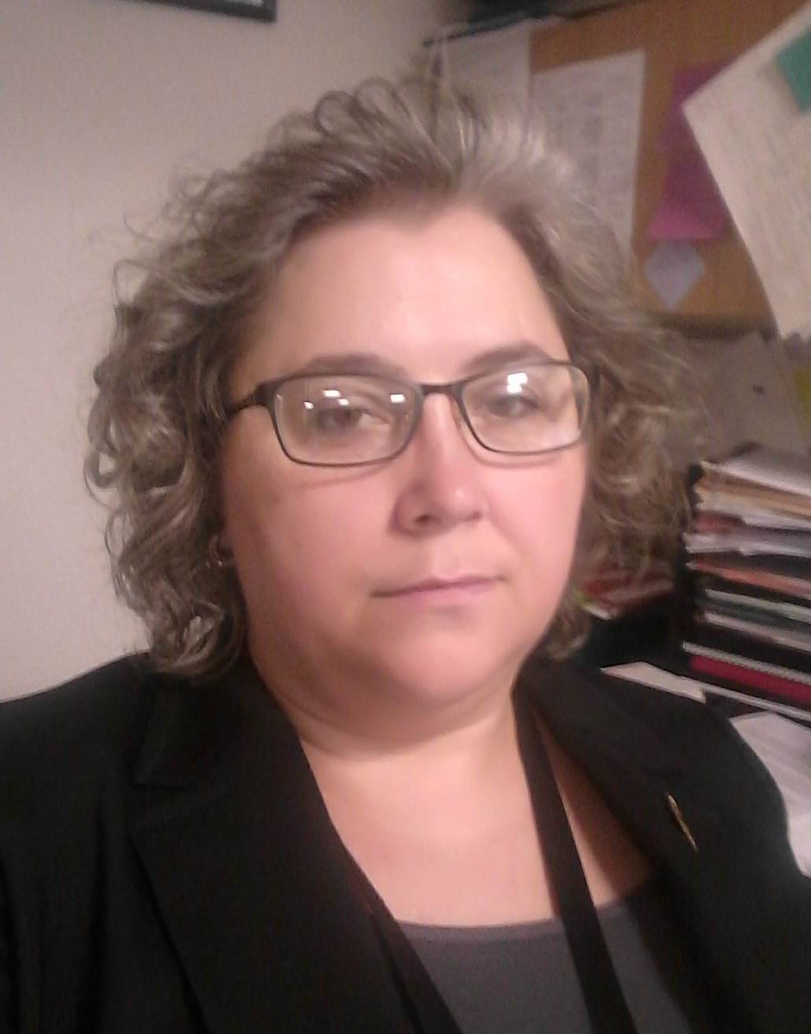
Office of Equity & Inclusion - Remote Presentation
Greg Evans EdM,
AVP for Equity and Inclusion
Tracy Weimer BS,
Project Coordinator
evansg@lanecc.edu
weimert@lanecc.edu

Slide 4
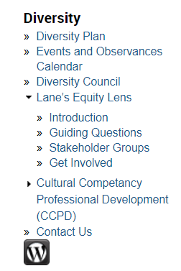

Locating the Equity Lens Toolkit Online
www.lanecc.edu/diversity
Expanded Navigation Menu
On Home page
Click to open Packet
Notes:
Packet https://www.lanecc.edu/sites/default/files/diversity/combined_toolkit_packet.pdf

Slide 5

Equity
Lens
Toolkit
equity@lanecc.edu
Notes:
Download the packet at https://www.lanecc.edu/diversity/lanes-equity-lens

Slide 6


Unpacking the Equity Lens Toolkit Packet
Diversity Values
Strategic Direction
Key Strategies
Principle Outcomes
Equity Lens Models
Strategic Objectives
Click to open Packet pdf

Slide 7

Diversity Values
“To ensure we realize our stated college values and actualize access, equity, and inclusion across the college, we are building and implementing an Equity Lens.
We will be identifying and supporting best practices for equity-related initiatives, with a strong commitment to equal employment and educational opportunity in all activities, programs, and services.”

Slide 8

Strategic Direction
In order to fully realize Lane’s commitment to these outcomes, we will develop a social justice framework (Equity Lens) to guide our work. This framework will provide structures, systems and support for:
Advancing individual and collective growth in cultural fluency, agility and competency across the institution
Bringing stakeholder groups together to identify and remedy barriers to social justice at LCC
Improving recruitment and retention of diverse students and staff
Increasing the range, scope and depth of diversity, equity and inclusion curriculum
Demonstrating leadership in social justice

Slide 9
Strategic Objectives
Integrate principles of social justice throughout the college learning and working environment
Develop a culture of inclusivity, and respect, through dialogue, outreach, education, and equitable policies and practices
Improve recruitment, retention, and support of diverse students, faculty, staff, and managers

Slide 10

Key Strategies
Office of Equity & Inclusion
You are Here
Create and Implement a Social Justice Equity Framework (Equity Lens)
Provide Cultural Competency Professional Development Opportunities
Institute Diversity Orientation & Development for Students and Staff
Improve Recruitment and Retention of Diverse Students and Staff

Slide 11

Principle Outcomes: What are we building?
Access – Opportunity for everyone who wishes to participate in the college
Inclusion – A sense of belonging as a valued member of decision-making at, and life of, the college
Equity – Fair and just opportunities for all employees and students to reach their academic and professional potential
Notes:
Principle Outcomes

Slide 12

A Closer Look
Equity Lens models previously developed have a single focus--usually race. Ours will be more broad and inclusive.
Another unique feature of Lane’s Equity Lens is that we will include both students and employees.

Slide 13

Our Model
Click to open Packet pdf
Lane’s Equity Lens Tool Worksheet
Packet Page
#

Slide 14
7
8

Slide 15
Equity Lens Toolkit
Frame the Question or item under scrutiny
What is the issue, policy, or process being examined?
Who is conducting this analysis -- who is at the table for this discussion?
6 Inquiry Questions
Frame the outcome of applying an Equity Lens,
including even small gains toward inclusion
What is the decision or action that will be taken in relation to the issue, policy, or process? (document interim plans and information gathering tasks)
Click to open Packet pdf

Slide 16
1.
Who is affected by content and current framing of this policy, program, practice, or decision? What are the potential impacts?
[Helpful ‘lists’ are on page 8 of the packet]

Slide 17
2.
How does this policy, program, practice, decision-making process, or decision increase access, equity, and inclusion? How does it produce or worsen any disparities?

Slide 18
3.
Who is being impacted by this decision-making process? How have stakeholders been intentionally invited to and empowered to participate in the decision-making process or practice?

Slide 19
4.
What are the barriers to more equitable outcomes around this policy, program, practice, decision making-process or decision?

Slide 20
5.
How will members of the college community identify, address, and mitigate negative impacts and the barriers identified previously/above? How will you support this work?

Slide 21
6.
How can we, as members of the college community, create an environment and culture that fosters healing and reconciliation to transform our structures, environments, and selves?

Slide 22

Perspective
Remember that the Equity Lens is a means of inquiry, and should never be used as a justification for a pre-determined outcome. Be mindful and transparent when assigning weight to the needs of any single group, especially as any single group over any other.
Consider relationships, alliances, and social capital that might be affected by the decision, policy, or process being considered.
Values won’t be represented as groups or individuals in your analysis, but if the decision-making body has agreed-upon values, it’s a good idea to make them explicit and name them at the beginning of the Equity Lens analysis.
Click to open Packet pdf

Slide 23
7
8

Slide 24

Equity Lens Tools – Additional Resources
Item | Source | Title
1 | LCC, Diversity Council & ELIT | Lane’s Equity Lens Toolkit
2 | Higher Ed Coordinating Commission | Oregon’s Equity Lens
3 | Portland Public Schools | Racial Equity and Social Justice Lens
4 | Multnomah County | Equity and Empowerment Lens
Notes:
LCC Equity Lens model worksheet https://www.lanecc.edu/diversity/lanes-equity-lens
HECC Oregon’s Equity Lens https://www.oregon.gov/highered/about/Documents/State-Goals/HECC-Equity-Lens-2017-reformat.pdf
PPS Equity and Empowerment Lens https://www.pps.net/Page/2305
Multnomah County Racial Equity Lens https://multco.us/diversity-equity/equity-and-empowerment-lens

Slide 25
Locating the Equity Lens Toolkit Online
www.lanecc.edu/diversity
Expanded Navigation Menu
On Home page
Click to open Packet
Notes:
Packet https://www.lanecc.edu/sites/default/files/diversity/combined_toolkit_packet.pdf

Slide 26


Please, Email your questions and comments to equity@lanecc.edu
equity@lanecc.edu
www.lanecc.edu/diversity

