Slide 1
Mid-Year Check-Up
Monitoring Your Budget
Brought to you by:
The Budget Office

Slide 2
The Mid-Year Check-Up
Where is your budget “sitting”?
Are your revenues coming in as expected?
Are your expenses in line with your M&S budget?
How is your PT budget holding up?
Are you able to change or close any POs?
Are there erroneous charges to your department?

Slide 3
The Budget Query
Budget queries are an important way to get a bird’s eye view of your budget.
Budget queries are performed in ExpressLane
After accessing ExpressLane, click on Financial Information and then on Budget Queries.

Slide 4
Creating a Budget Query
Create a query by:
Budget Status by Account
Budget Status by Organizational Hierarchy
Budget Quick Query
Payroll Expense Detail

Slide 5
Designing Your Report
First, choose the data columns you want on your report – continue
Second, choose your FOAP elements and if you want revenue accounts or not - submit

Slide 6
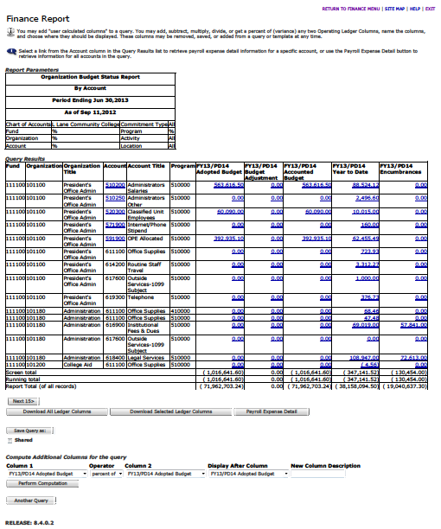
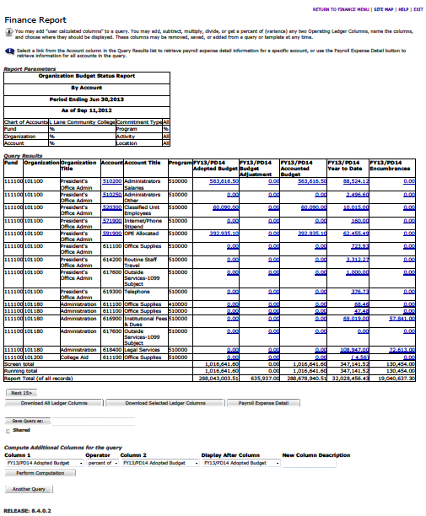
Data!!! Now What?

Slide 7
Downloading and Manipulating
As you can see, there is a lot of data!
Near the bottom of the screen are buttons for downloading your data into an Excel spreadsheet for viewing and manipulation.
Click on “Download Selected Ledger Columns”
At the prompt “What do you want to do with bwfksdld.csv”? Click on “open”.
The result is an Excel spreadsheet in csv format that you can format for your own use.
Remember to save file “AS AN EXCEL WORKBOOK”

Slide 8
Revenue and Expense Reports
ExpressLane Revenue and Expense Summary Report
Gives totals for each FOAP requested
Budget or Actual FOAP level data
Useful for tracking activity and unit performance
A lot of extra, duplicated, unnecessary data
Download into Excel
Develop a Macro specific to formatting needs

Slide 9
Reports and Tools – ExpressLane
Trx from/to one FOAP
Trx from/to one or more FOAP(s)
Budget remaining
Why is it NSF when it shouldn’t be?
Document History
Current Period & YTD activity
Budget Transfer
Multi-Line Budget Transfer
Budget Availability
Budget Availability -View unposted details
View Documents (With approval)
Budget Query

Slide 10
Reports and Tools – Banner
Incomplete Documents
Encumbrance Detail
Dept Budget Detail
Detail Trans Activity
Enter Change Order
Budget Summary Report
Grants Accounting
GL Transaction Detail
GL or OL Bal Summary
Print Change Order
Invoice Paid
Org Detail Report
View My Entries
Create PO
Print PO
Look up open PO
FGRIDOC
FGIENCD
FGIBDST
FGITRND
FPACHAR
FGIBDSR
FRIGITD
FGRGLTA
FGRFAAC
FPACORD
FAIVNDH
FGRODTA
FOADOCU
FPAPURR
FPAPORD
FPIOPOV(by vendor)

Slide 11
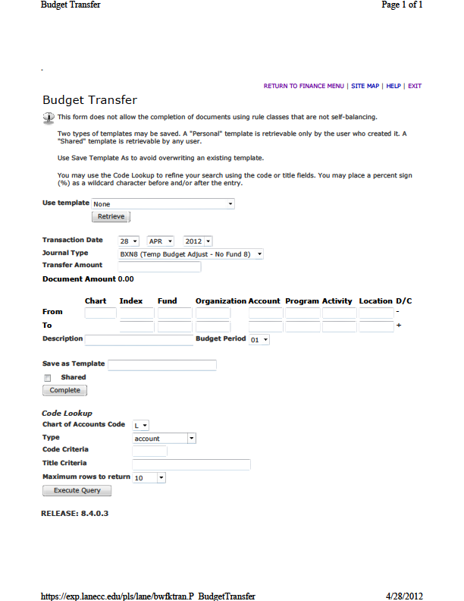
Budget Transfer Template in ExpressLane

Slide 12
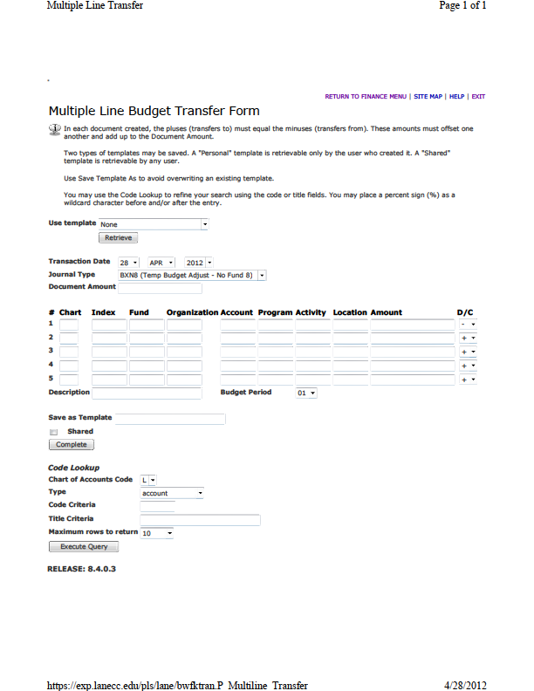
Multi-Line Budget Transfer in ExpressLane

Slide 13
Manual Budget Transfer Template
Notes:
Use for transfer that cross funds

