Slide 1
Campus Budget Conversation
April 28, 2015

Slide 2
Enrollment
Source: Institutional Research, Assessment and Planning, Budget Office

Slide 3
State Funding
Source: Audit Report, Budget Office

Slide 4
Revenue and Expenditures
Source: Audit Report, Budget Office

Slide 7
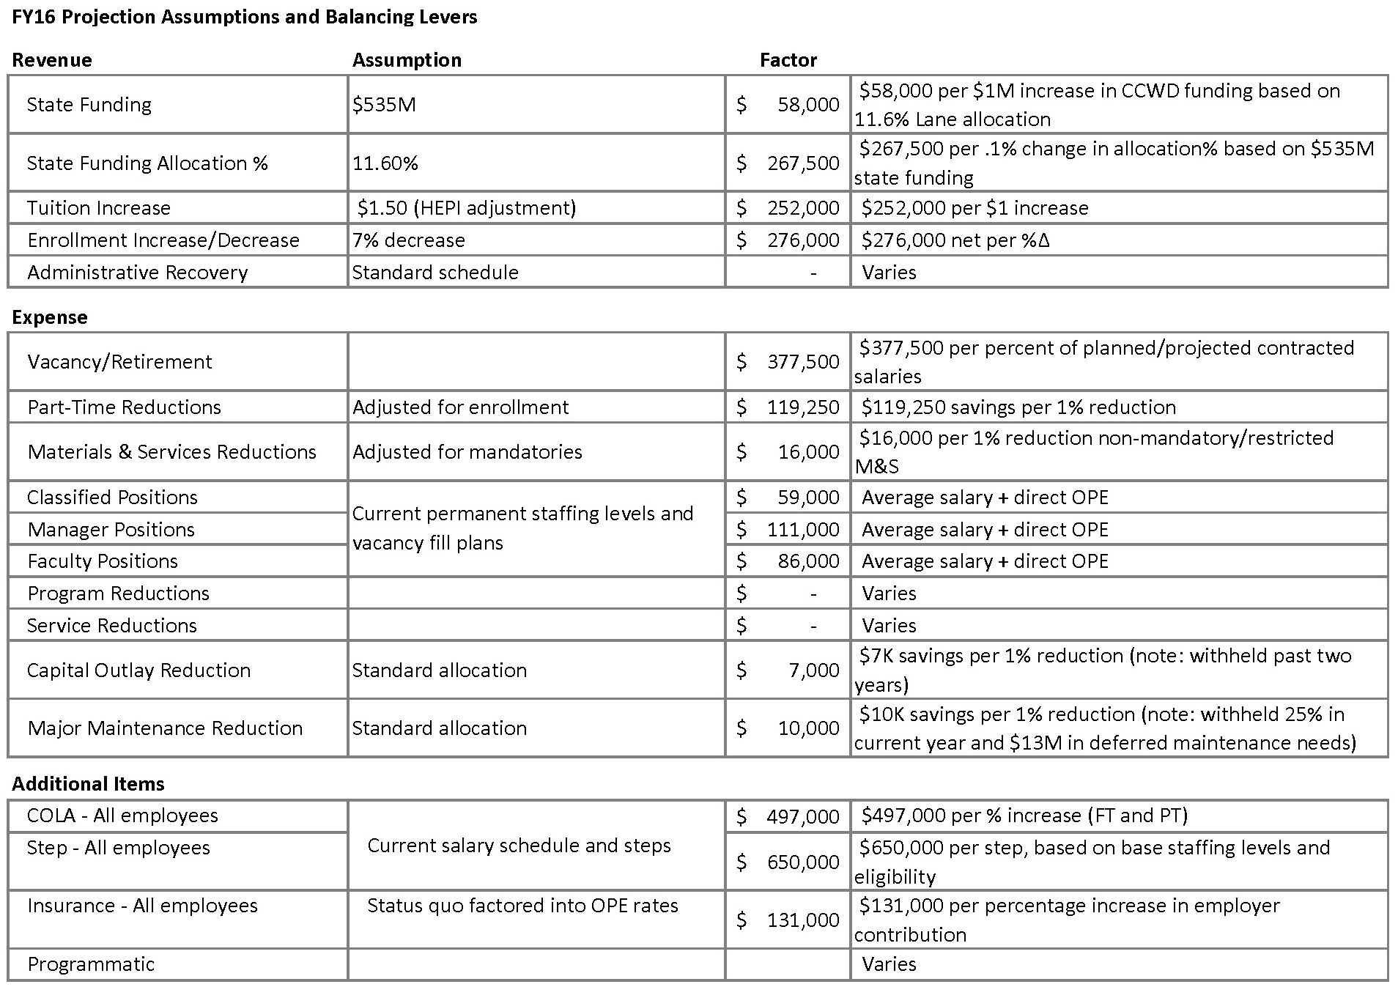

Slide 9
Resources
Budget website
www.lanecc.edu/budget
Budget blog
blogs.lanecc.edu/budget
IRAP website
www.lanecc.edu/research
Budget Office staff
budgetdevelopment@lanecc.edu
541.463.3005

Slide 10
2015 Timeline
May 13: Budget Committee
April 28: Campus Budget Conversation
March 11: Board Meeting: Planning Projections
February 15: Notice of Possible Reductions
February 4: All campus meeting

