Slide 1
“Budget 101
Back to the Basics”
Brought to you by the Budget Office

Slide 2
Budget Transfer vs. Journal Entry
A budget transfer moves your budget
A journal entry moves actual expenditures
A budget transfer can be processed by anyone who manages a department budget
A journal entry is processed mainly by the Budget Office, Grant Accounting or College Finance
Budget transfers are a BD01, BD02, BD04, BXN8 or BXP8
Journal entries are generally a JE16

Slide 3
BD What?
BD01 – Used to load Adopted Budget – Permanent – Budget Office only
BD02 – Used by the Budget Office via Native Banner to move budget amount from one area of your budget to another – Permanent – The adjustment will carryover into the Adopted Budget load for the next fiscal year and beyond.
BD04 – Used by the Budget Office to move budget – Temporary – The adjustment will not carryover into future fiscal years
BXN8 – Used by departments via ExpressLane to move budget in funds EXCEPT Fund 8
BXP8 – Used predominately by the Grant Department to move budget in only Fund 8

Slide 4
What can I transfer/What can’t I transfer?
Yes you can make transfers that affect:
M&S, Capital Outlay, Merchandise for resale, and ICP accounts.
PT personnel accounts
M&S to PT personnel & OPE
No you can’t make transfers that affect:
FT Personnel accounts (5102xx, 5203xx, 5405xx)
Revenue accounts
Grant accounts – unless you are a grant administrator
Transfer In/Transfer Out accounts
Different funds i.e.. From 111100 to 124XXX

Slide 5
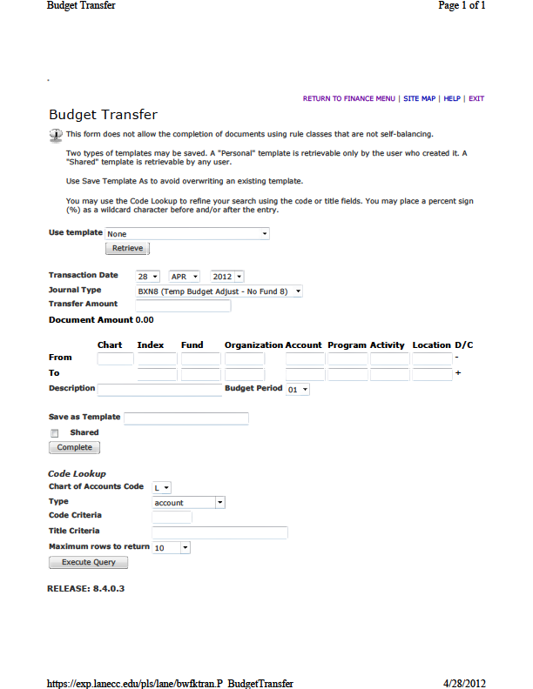
Budget Transfer Template in ExpressLane

Slide 6
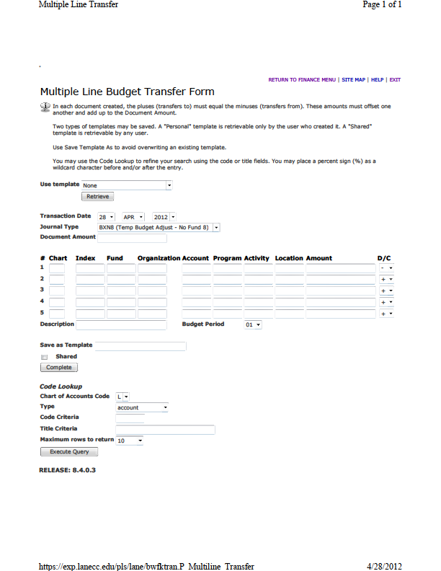
Multi-Line Budget Transfer in ExpressLane

Slide 7
Manual Budget Transfer Template
Notes:
Use for transfer that cross funds

Slide 8
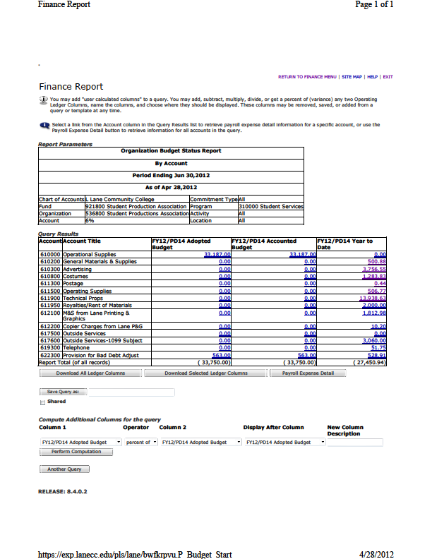
What The Budget Might Look Like
Notes:
In this example, Costumes and Technical Props have P-Card charges. As you can see, there is no budget for these two line items so we must “roll up” to the first line that has budget loaded. And in this example, the budget is in Operational Supplies and all Year-To-Date amounts under that line item are charged against Operational Supplies until you reach another line that has a budget loaded such as in this instance, “Provision for Bad Debt” has budget.

Slide 9
Monitoring Your P-Card Budget
P-Cards (Purchasing Cards) have only one FOAP associated with each card.
Once you know what FOAP is associated with your card, you can do a budget query in ExpressLane to determine how much money is in your budget.
Keep in mind that your P-Card FOAP may also be used for other expenditures when looking at your budget.
Most P-Cards are given an Office/Operating Supply FOAP that “rolls” up to the main Operating Supplies budget line.
As you can see in the next slide, your P-Card budget may be shared by other FOAPs. Your actual budget for your P-Card should be discussed with your Department Dean

Slide 10
Revenue and Expense Reports
ExpressLane Revenue and Expense Summary Report
Gives totals for each FOAP requested
Budget or Actual FOAP level data
Useful for tracking activity and unit performance
A lot of extra, duplicated, unnecessary data
Download into Excel
Develop a Macro specific to formatting needs

Slide 11
Income Credit Program (ICP)
What is it?
As defined in LCC’s COPPS:
ICP is designed to aid a department that generates special revenues from fees or charges that directly support a departmental activity or program within the general fund.
Only income that is identified or unique to a single department will be handled by the ICP program.

Slide 12
What can I do with the ICP?
Your department has instructional supplies that are attributed to a particular class and the department passes the cost of those supplies onto the student in the form of a fee. The fee charged each student and the supplies expenditure could be tracked via the ICP in funds that begin with 124XXX.
Fees are above and beyond tuition, are specific to a class supply, are not part of M&S, are anticipated for budgeting and must be budgeted before the revenue can be used for supplies.

Slide 13
Fees and Revenues
Mandatory Student Fees
Non-Mandatory Student Fees
User Fees
Other Fees and Charges
Sales from goods; used books, foods, etc.
Sales from services; cleaning, printing, etc.
Sales from events.

Slide 14
Expenditures
Clay, Paint, Silkscreen, Dry Mount Presses
Rents and Leasing costs
Printing and copying costs
Lotions & Oils
Dishes
Class Activities
Advertising
Non-Credit Instructors
Curriculum fees – Telecourses/Distance Learning
License fees – Telecourses/Distance Learning

Slide 15
ICP – Getting Started
A need is determined and a fee is established
The fee is attached to the class during construction – contact enrollment services
Students are assessed the fee upon enrolling in the class
Revenue is recorded in the ICP fund
Expenditures can then be made against revenue provided there is sufficient budget.

Slide 16
Setting Up Your ICP Budget
Departments are now allowed to begin assessing fees at the top of any term throughout the fiscal year; however, budgets are only adopted once. Not anticipating a new fee could delay your ability to utilize the funding received from that fee.
If you have a new fee to charge, alert the Budget Office as soon as you can so your budget can be included in the Adopted Budget.
The fee revenue budgeted and anticipated must equal the expense budgeted and anticipated.
If a new fee is started after the budget has been adopted, a Budget Change Request form must be submitted to the Budget Office.

Slide 17
Calculating Your ICP Budget
Your department has determined a need for a particular class or classes and the cost equates to $25 per student/per class
You have 30 students in each class and you are going to offer the class for three terms
30 students x $25 = $750 x 3 terms = $2,250
You request a revenue and expense budget of $2,250 in the FOAP associated with the class

Slide 18
ICP – What’s Not Allowed
Spending revenues without sufficient budget
Comingling ICP 124XXX and GF 111100 budgets or actuals
Using ICP funds for anything other than the specified purpose
Expecting 100% carryover of ICP funds to the next fiscal year (if overall budget is in deficit, extra ICP funds will be used to balance)

Slide 19
Other Questions???
Changing budget allocations…
Monitoring multiple programs rolling into one budget line
Process sequence

Slide 20
Reports and Tools – ExpressLane
Trx from/to one FOAP
Trx from/to one or more FOAP(s)
Budget remaining
Why is it NSF when it shouldn’t be?
Document History
Current Period & YTD activity
Budget Transfer
Multi-Line Budget Transfer
Budget Availability
Budget Availability -View unposted details
View Documents (With approval)
Budget Query

Slide 21
Reports and Tools – Banner
Incomplete Documents
Encumbrance Detail
Dept Budget Detail
Detail Trans Activity
Enter Change Order
Budget Summary Report
Grants Accounting
GL Transaction Detail
GL or OL Bal Summary
Print Change Order
Invoice Paid
Org Detail Report
View My Entries
Create PO
Print PO
Look up open PO
FGRIDOC
FGIENCD
FGIBDST
FGITRND
FPACHAR
FGIBDSR
FRIGITD
FGRGLTA
FGRFAAC
FPACORD
FAIVNDH
FGRODTA
FOADOCU
FPAPURR
FPAPORD
FPIOPOV(by vendor)

