Slide 1
Basic Budgeting

Slide 2
OVERVIEW
Budget Process Timeline
Fund Accounting
LCC’s Funds and Their Purposes
Balanced Budget – It’s the Law (ORS 294)
Revenues and Expenses
Monitoring Your Budget
  FOAP – the Keys to Retrieving Data
  Banner Reports
  Monitor Revenue and Expenses
  Working Capital (aka Fund Balance) – Planned vs. Unplanned Drawdowns
  Budget vs. Actuals – There is a difference
  How to Adjust Your Budget or Correct Miscoded Actuals
Questions and Answers
Future Budget Office Trainings

Slide 3
BUDGET DEVELOPMENT TIMELINE
 |  | Jul | Aug | Sep | Oct | Nov | Dec | Jan | Feb | Mar | Apr | May | Jun
1 | College Council reviews preliminary projections and “approach” to budget, develops principles, criteria, and priorities from strategic directions from council/unit plans.
2 | College Council identifies data elements for analysis.
3 | Centralized data gathered and reviewed for accuracy by departments and divisions and “certified” for use in budget development process.
4 | College Council reviews & sets assumptions, preliminary projections and finalizes “approach” (Phase 1 & Phase 2) to the budget following review by Finance Council, assures adherence with Long-Range Financial Plan
5 | Board review and approves principles, criteria, and priorities. Board approves projections, assumptions, and “approach”.
6 | Administration reviews data and, consistent with criteria and principles, develops proposals for reductions (includes working with divisions/departments)
7 | Units complete annual plans.
8 | Area Chairs and Vice-Chairs reviewing planning inputs for priorities for additions to budget and present to College Council (assure all stakeholder groups are represented).

Slide 4
BUDGET DEVELOPMENT TIMELINE - Continued
 |  | Jul | Aug | Sep | Oct | Nov | Dec | Jan | Feb | Mar | Apr | May | Jun
9 | Staff work on feasibility of Unit Plans for additions (includes checking with divisions/departments).
10 | Budget Subcommittee reviews priorities and proposals for additions, reductions.
11 | College Council reviews and assesses additions and reductions; finalizes and forwards to President.
12 | Preliminary proposals submitted to Board as information.
13 | Notice to Association if retrenchments proposed.
14 | Final recommendations submitted to Board
15 | Board receives budget recommendations and approves additions/reductions in programs and services.
16 | Budget allocations for special funds completed.
17 | Budget Office prepares the Budget Document.
18 | Budget Committee reviews proposed budget including reductions and additions; approves budget and forwards to the Board.
19 | Board adopts the budget and taxes are levied.

Slide 5
Descriptions of College Finances
Accuracy
Timeliness/Relevance
+Revenues
-Expenses
+Beg Fund Bal
+Revenues
-Expenses
-Ending Fund Bal
Projections
Budget
Accounting Actuals
Future
Present
Past

Slide 6
BUDGET
Defines reasonable outside limits for Resources and Expenditures
Provides overall picture of major revenue sources
Provides a general plan for how resources will be allocated
Provides for unforeseen or emergency needs
Must balance (i.e. total operating resources must equal total operating expenditures)

Slide 7
FUND
An accounting entity with a self-balancing set of accounts consisting of:
  Assets
  Liabilities
  Fund Balance
  Revenues
  Expenditures
  Transfers In and Out
Each type of fund allows LCC to organize, manage and insure observance of limitations and restrictions placed on the use of resources.

Slide 8
FUND I - GENERAL FUND
Fund I – Includes activities directly associated with operations related to the colleges educational mission. All public support and most tuition comes to this fund as revenue. Income Credit Program (ICP) is a sub-fund of Fund I.
Fund IX – Administratively Restricted Fund – This fund is used to account for specific programs where funds are administratively restricted to specific purposes. Activities in this fund generate revenue primarily through specific tuition or fees. For example, the technology fee and related expenses are accounted for in this fund.
When making budget projections Fund I and Fund IX are combined.

Slide 9
FUND II – INTERNAL SERVICE FUND
GAAP Definition: Internal Service Fund activities are those business functions performed by the institution primarily for institution support.
Internal prices are set to cover only direct costs of providing the service plus equipment replacement costs.
Lane Internal Service activities include Printing & Graphics, Warehouse, Wellness Program, Telephone Services and Motor Pool.
Exception: Printing & Graphics performs work for outside clients to help cover operating costs.

Slide 10
FUND III – DEBT SERVICE
FUND IV – CAPITAL PROJECTS
Fund III – Accounts for the accumulation of resources for, and payment of general long-term debt, principal and interest. Receives revenue from bond related property taxes and a transfer from the general fund for other debt.
Fund IV – Accounts for new construction, major remodeling projects and major equipment purchases. For example, this is the fund where bond projects, the Health & Wellness building and deferred maintenance projects are accounted for.

Slide 11
FUND V – FINANCIAL AID
FUND VII – AGENCY FUNDS
Fund V – Accounts for grants, loans and work study payments to students. With the exception of a college contribution to work study this is all a pass through of federal funds.
Fund VII – Accounts for funds held in trust for others such as student club accounts and early retirement accruals.

Slide 12
FUND VI – ENTERPRISE FUND
GAAP Definition: Enterprise activities are primarily intended to provide services to the public that support the mission of the government organization.
Prices are established by market rates and are intended to both cover costs and a contribution to overhead beyond operating costs.
LCC enterprise activities include the Laundry, CML, Food Services and the Bookstore.

Slide 13
FUND VIII – SPECIAL REVENUE FUND
This fund accounts for revenue sources that are legally restricted to expenditures for specific purposes – primarily grants from both government and private sources.

Slide 14
FEES AND REVENUES
Mandatory Student Fees
Non-Mandatory Student Fees
User Fees
Other Fees and Charges
Sales from goods; used books, foods, etc.
Sales from services; cleaning, printing, etc.
Sales from events
Property Taxes (Operating & Debt levies)
State Revenue
Inter and Intra Fund Transfers
Grants and Other Financial Aid

Slide 15
EXPENDITURES
Labor (approx 70% of Budgeted Expenses)
Rents and Leasing costs
Printing and copying costs
Maintenance & Repair (facilities, grounds, equip)
Operational Supplies (fuels, paper, dishes, items for Re-sale)
Class Activities
Advertising, Legal Services
Non-Credit Instructors
Curriculum fees – Telecourses/Distance Learning
License fees – Telecourses/Distance Learning
Utilities & Communications, Telephone
Travel & Training
Institutional Fees & Dues
Contractual (accounting & auditing services)
Debt Payments

Slide 16
FOAP:
FUND–ORGANIZATION–ACCOUNT CODE-PROGRAM
The Fund is an accounting entity with a self-balancing set of accounts.
The Organization tries to reflect the budget lines of authority sharing from the sub-departments to the departments to the divisions to the vice president and finally to the president.
The Account Code identifies differing types of expenditures.
The Program is defined by NACUBO standards and the State of Oregon reporting requirements (it indicates if the expenditure is for Instruction, Instructional Support, Student Services, Community Services, College Support, Plant Operations and Maintenance, Plant Additions, Financial Aid and Debt Service).

Slide 17
BANNER FOAP - EXAMPLE
The Fund for the General Fund is 111100
The Organization for Art/Design & Drawing is 621305
The Account Code for Operating Supplies is 611500
The Program for Lower Div Trx/Gen Acad is 111000
Put all together:
Fund Org AcctCode Program
111100 621305 611500 111000

Slide 18
WHAT IF I COLLECT MORE FEE MONEY THAN IS BUDGETED?
New fees that are approved during the fiscal year or fees that are already budgeted and are coming in higher than anticipated at the original budget adoption:
  Prepare a supplemental budget request showing both the complete revenue and expenditure FOAPs, the dollar amounts, and an explanation (“This fee was approved by the Board on 12/15/11. It is for students to reimburse the college for art supplies”.) (“This fee is for art supplies and has been consistently coming in at $25,000 over the last 3 years. We request the budgeted revenues and expenses be increased to $25,000.)
This request may be completed via email to the Budget Office from your Executive Dean or Manager

Slide 19
BD WHAT?
BD01 | Used to load Adopted budget | Permanent | Budget Office Only
BD02 | Used by the budget office Via Native Banner to move budget amount from one area of your budget to another | Permanent | The adjustment will carryover into the adopted budget load for the next fiscal year and beyond
BD04 | Used by the budget office to move budget | Temporary | The adjustment will not carryover into future fiscal years
BXN8 | Used by departments via ExpressLane to move budget in funds. |  | Except fund 8
BXP8 | Used predominately by the Grant Department to move budget in |  | Only Fund 8

Slide 20
BUDGET TRANSFER VS.
JOURNAL ENTRY
A budget transfer moves your budget
A journal entry moves actual expenditures
A budget transfer can be processed by anyone who manages a department budget
A journal entry is processed mainly by Grant Accounting or College Finance
Budget transfers are a BD01, BD02, BD04, BXN8 or BXP8
Journal entries are generally a JE16

Slide 21
WHAT CAN I TRANSFER? WHAT CAN’T I TRANSFER?
Yes you can make transfers that affect:
M&S, Capital Outlay, Merchandise for resale, and ICP accounts.
Non-Contracted personnel accounts (530xxx, 550xxx, 560xxx, 570xxx also 521000 & 540800) (must use individual accounts i.e. 530400 and NOT the budget account i.e. 530000
M&S to PT personnel & OPE (591900)
Payroll accounts that are NOT tracked by position #
OPE rates for these accounts is always the PT OPE rate
No you can’t make transfers that affect:
Contracted personnel accounts (5102xx, 5203xx, 5405xx)
Revenue accounts
Grant accounts – unless you are a grant administrator
Transfer In/Transfer Out accounts
Different funds i.e. from 111100 to 124XXX

Slide 22
DETERMINE WHICH TO USE
Movement “Vehicle” | When To Use
Budget Transfer – Most commonly used | Anyone who is authorized to monitor and manipulate budgets can initiate a budget transfer. Use this to move budget amounts between accounts/orgs within the same fund.
Journal Entry/Voucher | Used to move actual (not budget) dollar amounts (College Finance). More rarely used to move actual dollar amounts connected with an Inter- or Intra- fund transfer (Budget Office)

Slide 23
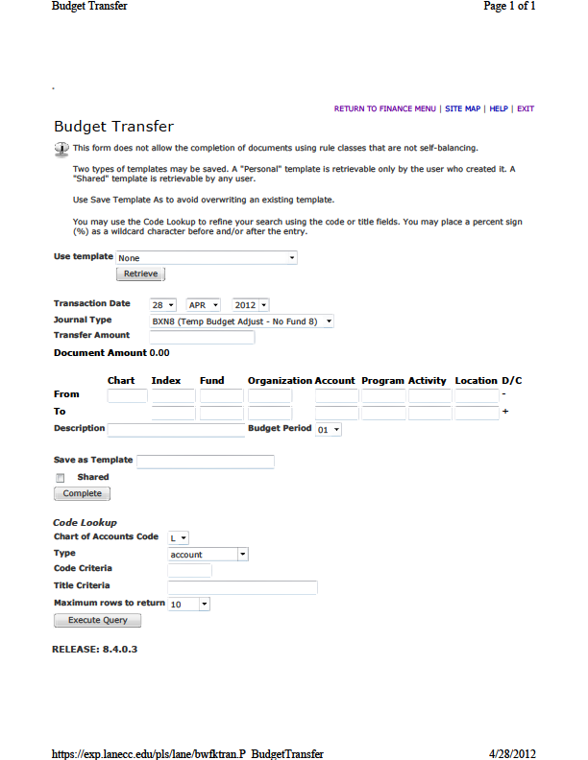
BUDGET TRANSFER TEMPLATE
IN EXPRESSLANE

Slide 24
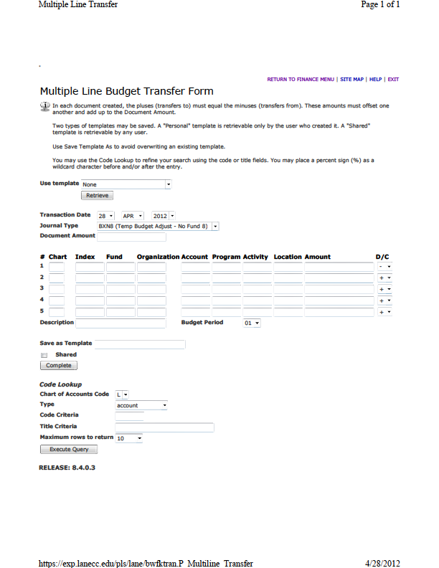
MULTI-LINE BUDGET TRANSFER IN EXPRESSLANE

Slide 25
MANUAL BUDGET TRANSFER TEMPLATE
Notes:
Use for transfer that cross funds

Slide 26
FINANCIAL REPORTS
Provides accurate accounting of financial performance (operating revenues and expenditures) on a monthly (and fiscal year) basis.
Allows comparison of budget or projection to actual performance.
Historical record of financial reports provides basis for future projections.
Watch for a future Budget Office hands-on training for using Banner, Queries, Reports and other tools for monitoring your budget.

