Slide 1
OEBB 2019-20 Open Enrollment Presentation
Moda Health

Slide 2
Agenda
Medical & Pharmacy
Overview of network & plan options
Benefit changes
PCP 360
Vision
Overview of plan options
Dental
Overview of networks & plan options
Member Resources

Slide 3
Medical and Pharmacy
Moda Health

Slide 4
Plans and network options
All OEBB plans will use Moda’s large Connexus Network
Service area is statewide
Coordinated and non-coordinated-care options
Medical Plans 1, 2, 6 & 7
Retirees & COBRA members living outside of the Connexus service area will use Moda’s rental networks
First Choice Health Network (FCH) for residents in Washington and Montana (excluding Southwest Washington)
Endeavor Providence for residents of Alaska
The Private HealthCare Systems (PHCS) is available to residents of all other states
To find in-network providers – members will want to contact Moda Medical Customer Service

Slide 5
How to participate in coordinated care and receive enhanced benefits
Choose a PCP 360 with Moda
A PCP 360 delivers full-circle care, coordinating your care with other providers as needed. They are high-quality primary care providers who will partner with you to be accountable for your health.
Each member of your family gets a choice
Each enrolled member can choose coordinated care to receive enhanced benefits. Each can also choose their own PCP 360.
Use your PCP 360 for all of your primary care needs
No referrals required to see specialists
Choose a PCP 360 at any time during the year
Enhanced benefits are effective as of the first of the same month in which you make the selection
Premium is the same for coordinated care or non-coordinated care
Receive an enhanced benefit level when you choose coordinated care

Slide 6
New Moda medical plans!
Medical Plan | Deductible |  | Out-of-pocket |  | Primary care |  | Specialist care |  | Urgent care
 | Coordinated | Non-coordinated | Coordinated | Non-coordinated | Coordinated | Non-coordinated | Coordinated | Non-coordinated | Coordinated | Non-coordinated
Plan 1² | $400 | $500 | $2,850 | $3,250 | $20¹ | 20% | $40¹ | 20% | $40¹ | 20%
Plan 2² | $800 | $900 | $3,850 | $4,250 | $20¹ | 20% | $40¹ | 20% | $40¹ | 20%
Plan 6² HSA Optional | $1,600² | $1,700² | $6,400² | $6,750² | 15% | 20% | 15% | 20% | 15% | 20%
Plan 7² HSA Optional | $2,000² | $2,100² | $6,500² | $6,750² | 20% | 25% | 20% | 25% | 20% | 25%
¹ Deductible waived
² If enrolled in a Moda medical plan, each covered individual must choose a PCP 360 with Moda for that individual to receive the enhanced “coordinated” benefit under that plan when using a provider in the Connexus Network. If an individual has not chosen a PCP 360 with Moda, they will receive the “non-coordinated” benefit shown in the right column if using a provider in the Connexus Network. Any services by a provider outside the Connexus Network will be paid at the “out-of-network” level regardless of whether the individual has chosen a PCP 360 with Moda or not.

Slide 7
Incentive Care Benefits
Members on coordinated care with chronic conditions such as asthma, heart conditions, cholesterol, high blood pressure and diabetes have an incentive care office visit benefit.
Medical Plan | Incentive Care Office Visit
 | Coordinated | Non-Coordinated
Plan 1² | $15¹ | 20%
Plan 2² | $15¹ | 20%
Plan 6² HSA Optional | 15% | 20%
Plan 7² HSA Optional | 20% | 25%
¹ Deductible waived.
² If enrolled in a Moda medical plan, each covered individual must choose a PCP 360 with Moda for that individual to receive the enhanced “coordinated” benefit under that plan when using a provider in the Connexus network. If an individual has not chosen a PCP 360 with Moda, they will receive the “non-coordinated” benefit shown in the right column if using a provider in the Connexus network. Any services by a provider outside the Connexus network will be paid at the “out-of-network” level regardless of whether the individual has chosen a PCP 360 with Moda or not.

Slide 8
Out-of-area dependent coverage
Part-time
Full-time
Dependents who live part-time outside of the Connexus Network service area (like college students) can still choose a PCP 360 for coordinated care and receive enhanced benefits
Notify your employer and Moda Customer Service of the dependent’s address change for access to our travel network for in-network benefits away from home
Primary care outside of the Connexus Network service area, from someone other than their designated PCP 360, will be at the “not my chosen PCP 360” level
Early retirees, COBRA members and dependents who live full-time outside of the Connexus Network service area are not eligible for coordinated care and enhanced benefits

Slide 9
How to choose a Moda PCP 360
Call Moda Customer Service
866-923-0409
Log in to myModa
You will be able to choose your PCP 360 beginning in September
Note: you and your family will have the ability to choose a PCP 360 at any point during the year and will begin receiving the enhanced benefits effective the first of the month you have chosen your PCP 360 with Moda.

Slide 10
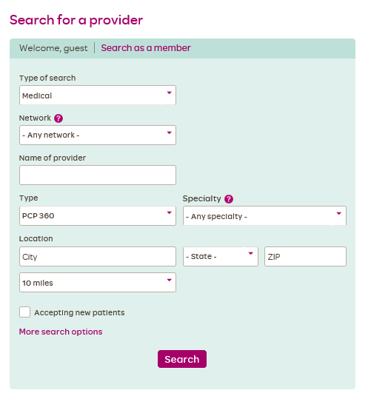
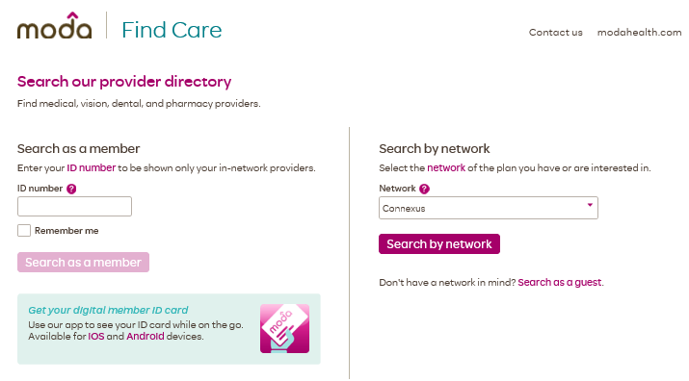
Find Care — Moda’s online provider directory
Allows you and your family to search for PCP 360s

Slide 11
Pharmacy benefits
 | Medical Plans 1-2 | Medical Plans 6-7
Out-of-pocket maximum | Accrues towards maximum cost-share | Accrues towards out-of-pocket maximum
Retail |  | Coordinated care | Non-coordinated care
Value | $4 per 31-day supply | $4* per 31-day supply | $4* per 31-day supply
Select generic | $12 per 31-day supply | 20% | 25%
Preferred brand | 25% up to $75 per 31-day supply | 20% | 25%
Non-preferred brand** | 50% up to $175 per 31-day supply | 20% | 25%
Mail
Value | $8 per 90-day supply | $8* per 90-day supply | $8* per 90-day supply
Select generic | $24 per 90-day supply | 20% | 25%
Preferred brand | 25% up to $150 per 90-day supply | 20% | 25%
Non-preferred brand** | 50% up to $450 per 90-day supply | 20% | 25%
Specialty
Preferred brand | 25% up to $200 per 31-day supply | 20% | 25%
Non-preferred brand** | 50% up to $500 per 31-day supply | 20% | 25%
* Deductible waived
**A formulary exception must be approved for non-preferred brand prescription medication.

Slide 12
Coverage for infertility services
New!
Moda is adding coverage for infertility services, including:
Diagnosis and surgical treatment of underlying causes of infertility
Ovulation induction and intrauterine insemination
This benefit will be available on all Moda medical plans 1 through 7 starting October 1, 2019.

Slide 13
Virtual Visits: ohsu.edu/virtualvisits.com
Urgent care from your home
Visit with a licensed Oregon Health & Science University (OHSU) doctor, physician assistant or nurse practitioner via computer or mobile device
Use Virtual Visits for
A cold, sore throat, stuffy nose, cough, the flu, congestion and nausea
Allergy, poison ivy or oak, bites, stings and more!
Benefit is the same for coordinated care and non-coordinated care
Plans 1-5
$10 copay, not subject to the deductible
Plans 6-7
$10 copay after the deductible has been met

Slide 14
Vision
Moda Health

Slide 15
Vision plan options – no changes!
Vision plan options | Opal
Benefit maximum | $600
Eye examinations Frequency: once per plan year | 100%*
Lenses Frequency: contacts or one pair of lenses per plan year | 100%*
Frames Frequency: one pair per plan year for members under age 17; one pair per every two plan years for members age 17 and older | 100%*
*Moda Health pays 100% up to the plan’s benefit maximum

Slide 16
Vision — key things to remember
You may see any licensed ophthalmologist, optometrist or optician
1
Receive discounted rate from a Moda-contracted provider (use Find Care ― Moda’s online provider directory)
2
3
Benefits run on a plan year basis (Oct. 1 – Sept. 30)
4
Benefit maximum includes exam and hardware

Slide 17
OEBB Dental
Delta Dental

Slide 18
Overview of plan options
No plan changes!
We continue to offer Plans 1 & 6

Slide 19
Dental plan options
Plan options | Plan 1 | Plan 6
Network | Delta Dental Premier
Deductible | $50 | $50
Benefit maximum | $2,200 | $1,200
In-network, members pay
Preventive/diagnostic | 30% - 0% | 0%
Restorative | 30% - 0% | 20%
Major restorative - Crowns/onlays | 30% - 0% | 50%
Prosthodontic -Implants | 30% - 0% 30% - 0% | 50% 50%
Orthodontic (Lifetime maximum — $1,800) | 20% | N/A
Occlusal guards (Night guards* and athletic mouth guards) | 50% | 50%
Nitrous oxide | 50% | 50%
*$250 maximum, once every 5 years

Slide 20
Delta Dental highlights
Delta Dental Premier Network is the largest dental network in Oregon and nationwide
Over 2,400 providers in Oregon & over 156,000 providers nationwide
Evidence-based approach to dentistry with a focus on preventive care
Health through Oral Wellness®
Comprehensive, patient-centered wellness program

Slide 21
Member Resources
Moda Health

Slide 22
www.modahealth.com/oebb
Want to learn more about health coaching?
Choosing your PCP 360? You’ll need to log in to your myModa account and follow the instructions
Looking for a PCP 360?

Slide 23
myModa – your online member portal
See your benefits & Member Handbook
Choose a PCP 360
Check claims and review electronic explanations of benefits (EOB)s
Download your member ID card
Healthcare Cost Estimator Tool
Access member care resources
Health coaching
Prescription Price Check
Healthcare Cost Estimator

Slide 24
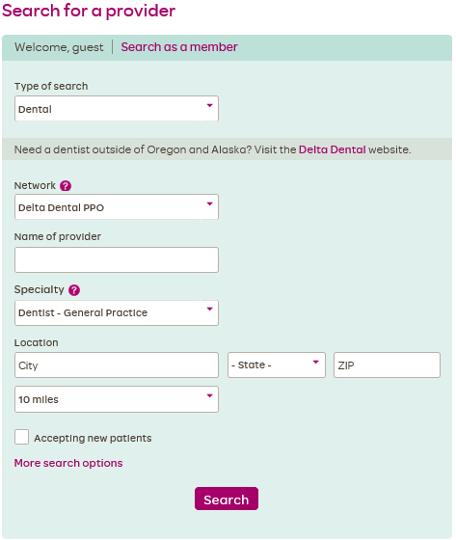
Find Care
Search for providers in your network
Thinking about the Exclusive PPO plan for dental? Use Find Care to search for providers.
Medical
(Connexus)
Dental
(Delta Dental Premier or Delta Dental PPO)

Slide 25
Customer Service
Available Monday through Friday from 7:30 a.m. to 5:30 p.m.
Medical/Vision 866-923-0409
Pharmacy 866-923-0411
r
Dental 866-923-0410
Or email Moda at OEBBquestions@modahealth.com

