Slide 1
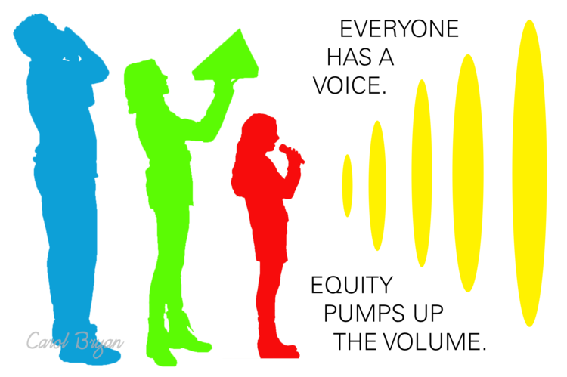
What is an
Equity Lens?
Notes:
Welcome. Introduce ourselves and our connection to this work.

Slide 2
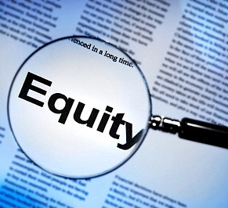
Equity Lenses are usually framed by versions of the five following questions.
Additional questions are often added specific to organizational needs.
Who are the groups affected by this policy, program, practice or decision? And what are the potential impacts on these groups?
Does this policy, program, practice or decision ignore or worsen existing disparities or produce other unintended consequences?
How have you intentionally involved stakeholders who are also members of the communities affected by this policy, program, practice or decision in the decision-making process?
What are the barriers to more equitable outcomes around this policy, program, practice, or decision?
How will you mitigate the negative impacts and address the barriers identified above?
There is a sixth question often asked. Lane’s Equity Lens will include a version of this question.
Have can we create space for healing and reconciliation to transform our structures, environments, and selves?
Notes:
Equity lenses are usually framed by a set of questions that re-frame institutional decision-making.
There are usually versions of 5 core questions
Other questions are also added as needed by institution
There is a sixth question also included as the core of many equity lenses

Slide 3
An Example
City of Ottawa
Notes:
An example can help us see what an equity lens might look like
City of Ottawa

Slide 4
City of Ottawa Equity Lens
“The Equity and Inclusion Lens is like a pair of glasses. It helps you see things from a new perspective. It helps you be more effective in your everyday work by getting a clearer focus and more complete view. This way, you can contribute to the full inclusion and participation of all residents and employees so that everyone can benefit from a vibrant city.”
Notes:
Definition

Slide 5
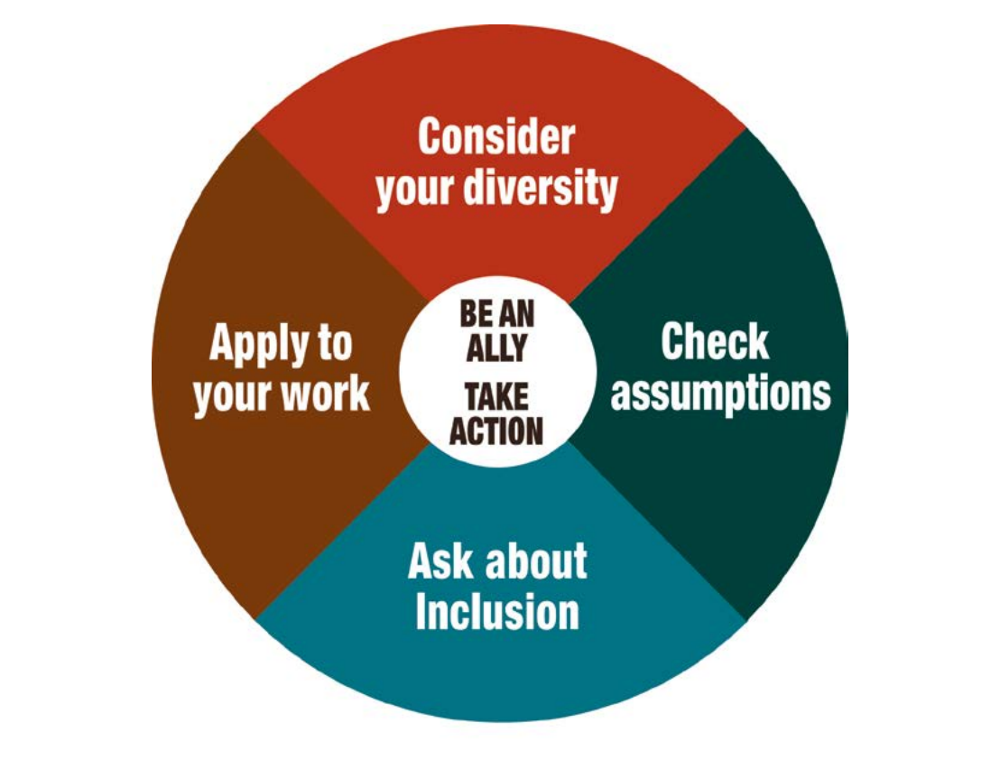
Visualization of the City of Ottawa’s Equity Lens
Notes:
The Ottawa Equity Lens model has a really helpful visual that includes the 5 core components
We’re going to walk through each of the five areas of this model as an example

Slide 6
Notes:
Question 1: Have you considered the diversity of your organization

Slide 7
Notes:
Question #2: Have you checked your assumptions?

Slide 8
Notes:
Question #3: Have you considered who is not included in your work, what contributes to this exclusion, and what you could do differently to ensure inclusion?

Slide 9
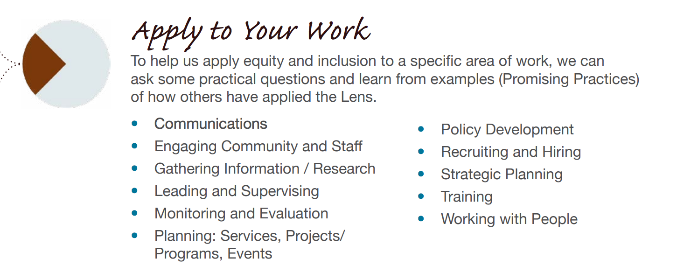
Notes:
Question #4: How can you apply what you’ve learned to increase equity in the institution?

Slide 10
Notes:
Question #5: How do you take action and be an ally to ensure greater equity?

Slide 11
Lane’s Equity Lens
will used to reassess systems and decision-making to achieve access, equity, and inclusion on a college-wide level.
Notes:
Diversity Council worked to create a basic framework for the process of building Lane’s Equity Lens last year. We’re going to share the working draft of the components of the framework with you.
There will be an opportunity in the forum and on the Conversation Kit to offer feedback on this framework.
Your lens is focused on helping is re-think the way we approach decision-making and is focused on three key areas: access, equity, and inclusion

Slide 12
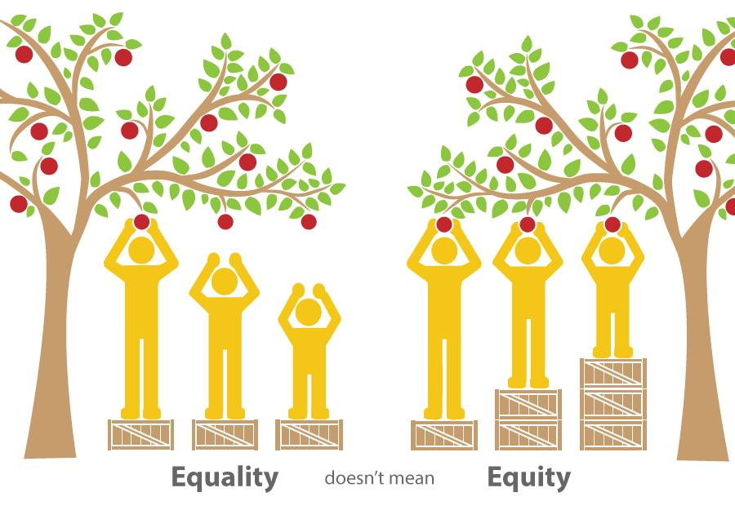
Equality vs Equity
Notes:
Equity and Equality are terms often used interchangeably. It’s key to understand the difference between these two terms in order to understand why we have taken on the work of building an Equity Lens and why we are moving away from the diversity model

Slide 13
Equality proposes that we offer the same exact opportunities and supports to everyone. This approach assumes that all people are all starting from the same place with the same needs and that the same opportunities and support will allow them to live full, healthy lives. As we know, social, political, and economic inequalities mean that this is not the case.
Notes:
One size fits all approach. Everyone gets exactly the same supports regardless of where they start or what their actual needs may be.

Slide 14
Equity is more messy and complex. It asks us to understand where individuals actually are and what their specific needs may be, and to then provide opportunities and support that meet their specific needs and thus allow them the chance to live full, healthy lives. Unlike equality, equity strives to ensure that everyone has access to equal results and outcomes regardless of their starting point.
Notes:
Focused on fairness rather than equality. Equity focuses on making sure that each person/group gets the specific support they need given where they start and what their actual needs are in order to ensure that they have a fair shot at equitable outcomes.

Slide 15
Access ensures that individuals from a broad range of backgrounds can gain access to public institutions, spaces, and services, and have full participation in political, social, economic, and cultural life.
Notes:
Access is the first step. We have to ensure that everyone who wants to participate in the college can access opportunities. For example individuals who live in rural Lane county but can’t afford a car, insurance, and gas money often can’t access the main campus given its location and the lack of mass transportation options outisde the metro area.

Slide 16
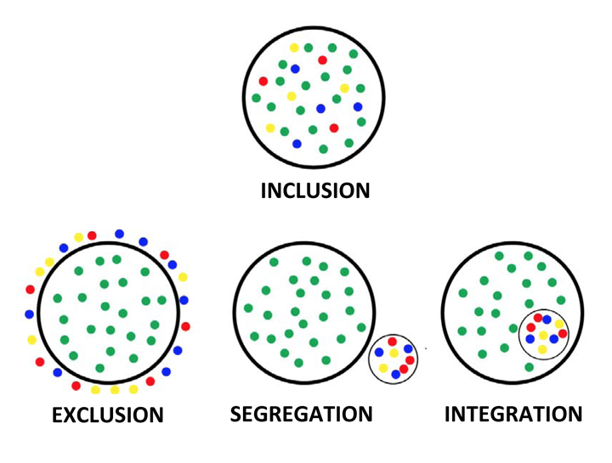
Inclusion is the degree to which a group, institution, or organization makes genuine space for individuals from all backgrounds to fully participate in decision-making processes and social planning.
Notes:
Inclusion involves more than just having individuals that represent diverse backgrounds present. It requires us to make genuine space for and provide supports to those from diverse backgrounds so they are fully included in the organization in meaningful ways.

Slide 17
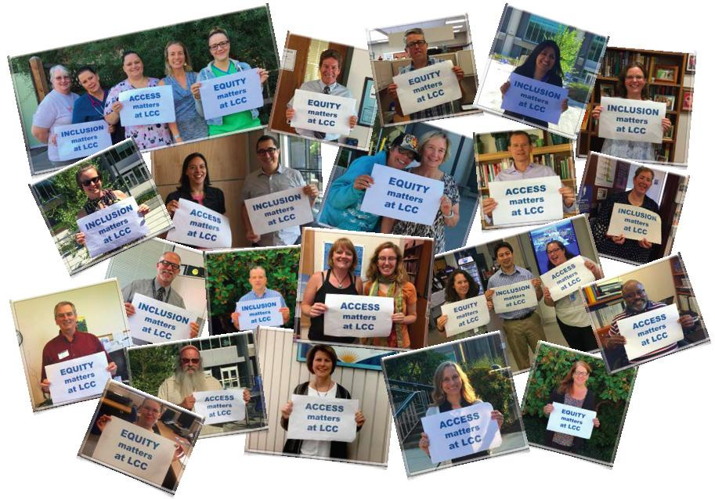
Unique Features of Lane’s Equity Lens
Intersectional
Encompasses entire campus community
Notes:
Most equity lenses previously developed have a single focus--usually race. Ours will be more broad and inclusive and allow us to talk about the effects of multifaceted oppressions through the use of intersectionality.
In most educational institutions that have equity lenses the lens focuses only on students. Lane’s Equity Lens will encompass both students and employees.

Slide 18
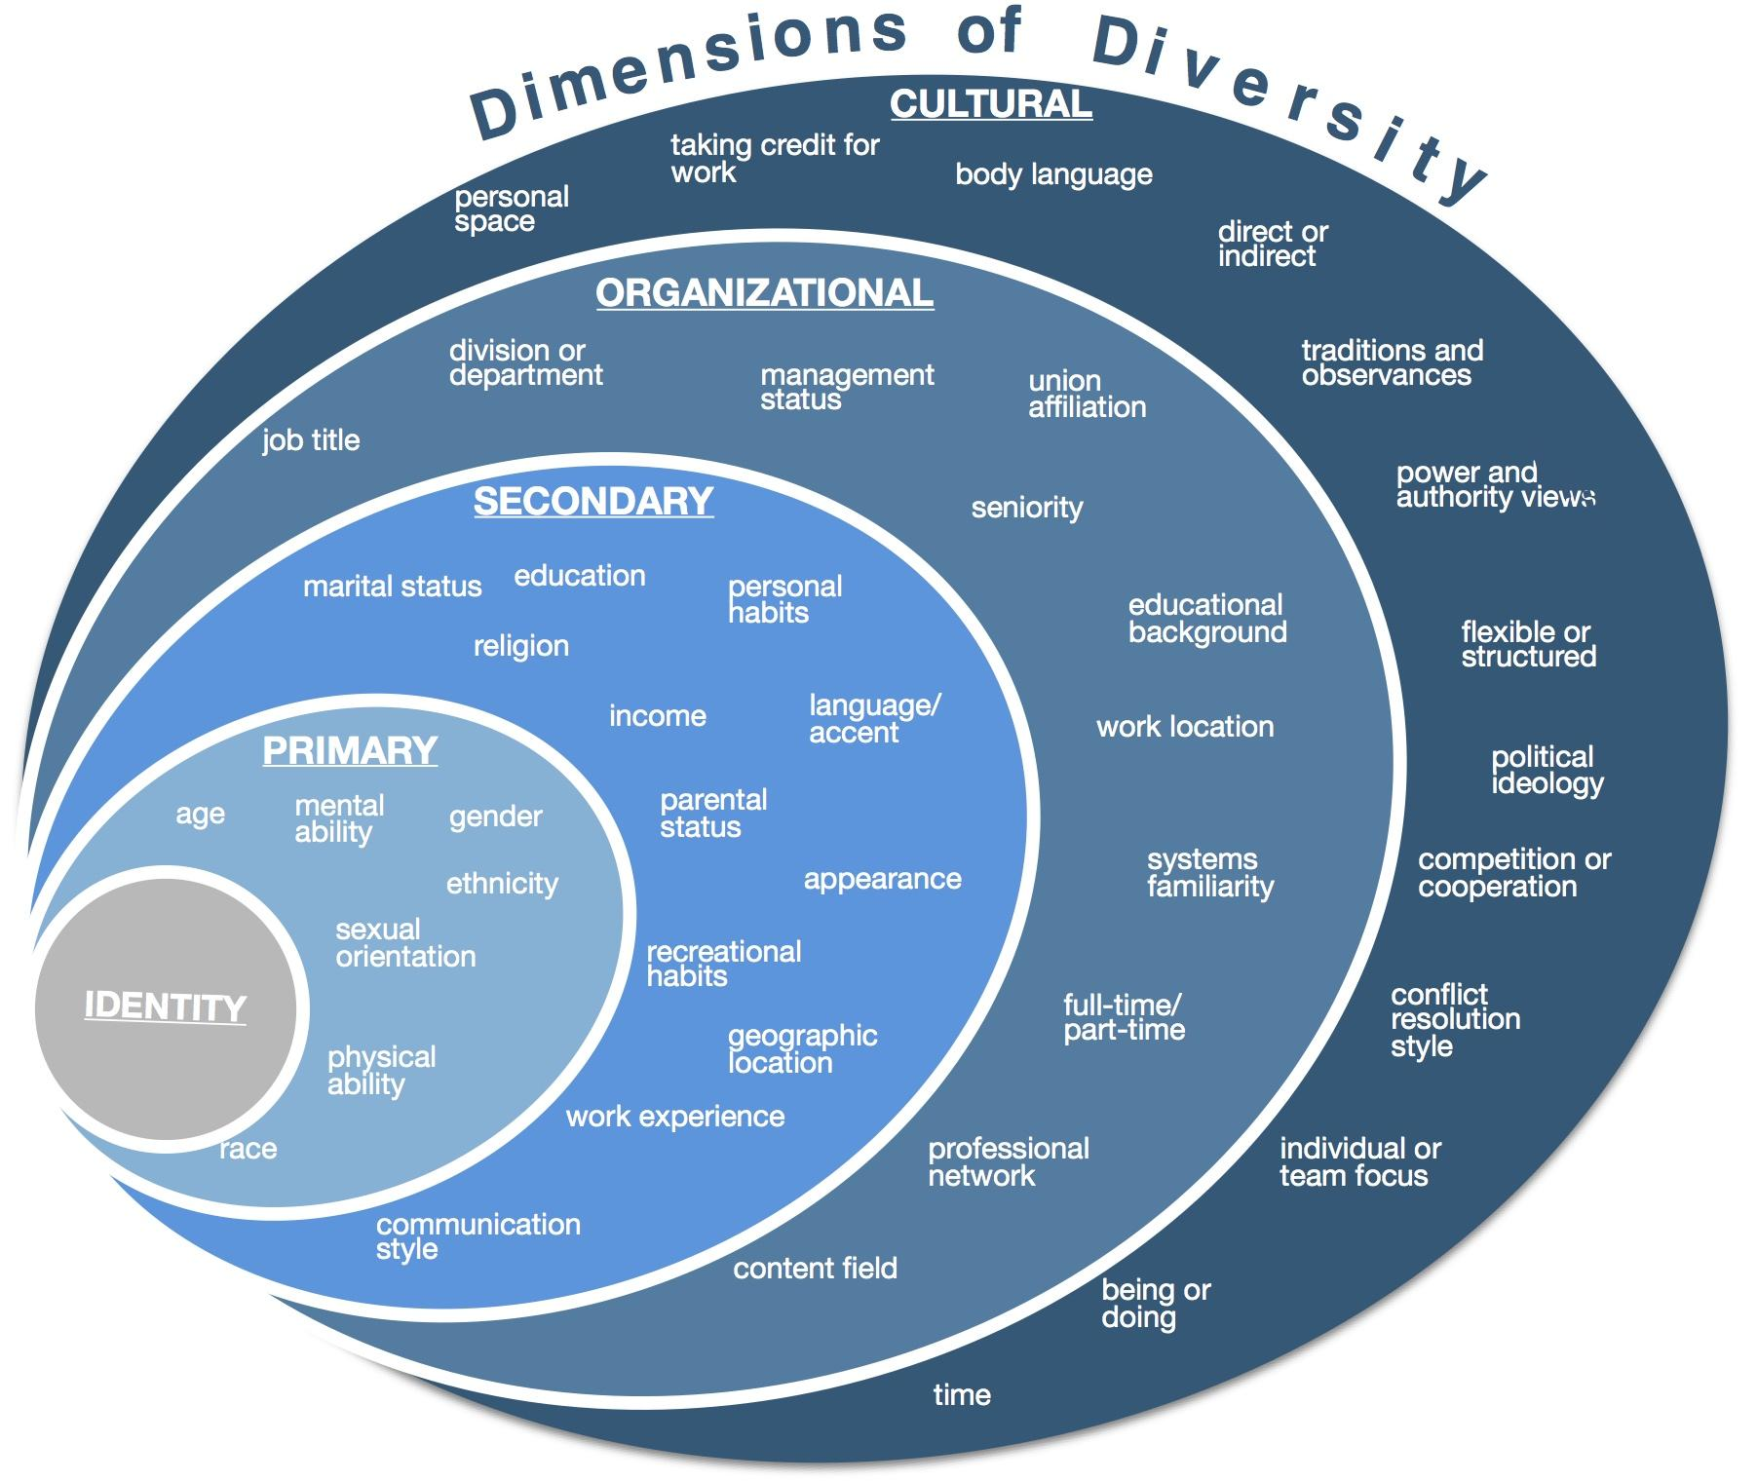
Intersectionality is a term coined by American civil rights advocate Kimberlé Williams Crenshaw in the late 1980’s. The term is used to describe the ways in which social identities--such as gender, race, class, ethnicity, religion, sexuality, etc--intersect and overlap in ways that do not allow these identities and related systems of oppression--such as sexism, racism, classism, bigotry, homophobia, etc--to be examined separately.
Notes:
Discuss definition

Slide 19
Vision: Through a framework of social justice, the Equity Lens helps us to acknowledge the existence and causes of systemic inequity at Lane. It provides opportunities for intentional healing, reconciliation, and empowerment. Honest, transparent, and consistent use of this lens enables the campus to create a culture of accountability and empower all members of our community.
Notes:
Our working vision statement

Slide 20
Framework for Action
Our work will help us develop a set of principles that sustain the institution in a way that ensures access, equity, and inclusion at all levels. To accomplish this our work will focus on:
Impacts of actions and decision-making
Illuminating and alleviating disparities experienced by underserved and underrepresented groups
Expanding opportunities
Transforming the community through healing and nurturing
Recognizing and bridging gaps of understanding and communication
Facilitating inclusive collaboration
Empowering all members of the college community to participate in this work
Encouraging personal and professional growth for all members of the community
Ensuring accountability in the consistent implementation of the lens
Building inquiry and assessment into all college systems at every level
Expanding beyond traditional diversity-work-stakeholders to include other voices and other communities
Increasing recruitment and retention of staff and students who are supportive of Equity Lens work
Developing a set of principles that sustain the institution in a way that ensures access, equity, and inclusion at all levels
Notes:
Our working framework for action

Slide 21
Guiding Questions
We’ll use questions to ensure our focus is appropriate, and to evaluate individual issues in the equity lens framework.
Are the tone, word choice, layout, and graphics of our “public face” in alignment with our movement toward access, equity, and inclusion?
Are the tone, word choice, layout, and graphics of our “internal” face in alignment with our movement toward access, equity, and inclusion?
Have we created a safe environment to participate in Equity Lens work?
Are we aware of the ways in which our equity lens is impacted by our individual, institutional, and systemic biases?
Does the work resulting from our equity lens foster improvement at all of the following levels: individual, institutional and systemic?
Do we have structures in place to ensure that the work resulting from the equity lens is collaborative and transparent across the institution?
What assessment mechanisms have we built into the equity lens that will allow for continual improvement of both the lens and the work resulting from it as we move forward?
What are the specific ways that Lane’s Equity Lens is expected to reduce disparities and enhance access, equity, and inclusion?
Can we realistically meet the goals of access, equity, and inclusion framed by the equity lens?
Have we clearly articulated Lane’s Equity Lens and expectations to all stakeholders? How are we going to get buy-in across campus?
Have we ensured that Lane’s Equity Lens can help us heal and transform our structures, environments, and selves?
Notes:
Our working draft of our guiding questions

Slide 22
Stakeholder Lists
Who is affected by this work? Who is benefited or burdened? Who has a perspective or narrative to contribute?
See handout for a draft of Lane’s Stakeholder Lists
Notes:
See the handout we provided for details

Slide 23
An Equity Lens is
A collaboratively created framework for decision-making
A way to reframe decision-making at the institutional level in ways that work to increase equity
A cultural shift
A new way of thinking about how we approach decision-making and who is included in that process
An opportunity to transform the institution
Notes:
Discuss what features do define an equity lens

Slide 24
An Equity Lens is not
A quick fix/band aid
A weapon
An imposition
A panacea
A marketing strategy
Notes:
Discuss what an equity lens is not and why it’s equally important to understand what it’s not.

Slide 25
Questions? Comments? Concerns? Contributions?

