Slide 1
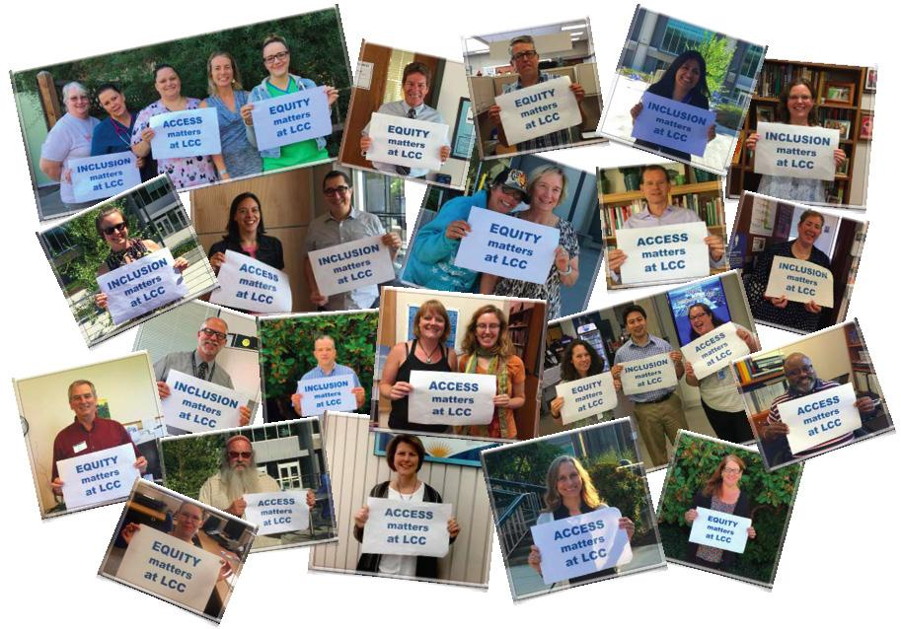
Welcome to the Building Equity Together Forum!
We’re so glad you joined us.

Slide 2
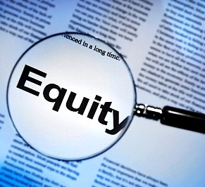
Equity is messy and complex. It asks us to understand where individuals actually are and what their specific needs may be, and to then provide opportunities and support that meet their specific needs and thus allow them the chance to live full, healthy lives. Unlike equality, equity strives to ensure that everyone has access to equal results and outcomes regardless of their starting point.
What is equity?

Slide 3
Access ensures that individuals from a broad range of backgrounds can gain access to public institutions, spaces, and services, and have full participation in political, social, economic, and cultural life.

Slide 4
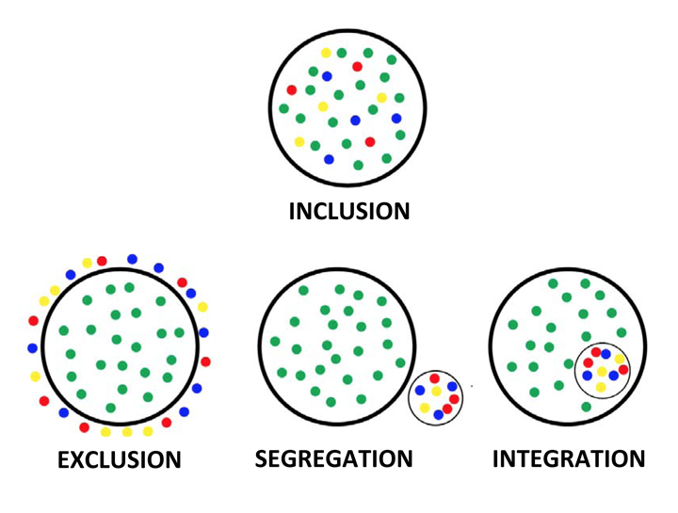
Inclusion is the degree to which a group, institution, or organization makes genuine space for individuals from all backgrounds to fully participate in decision-making processes and social planning.

Slide 5
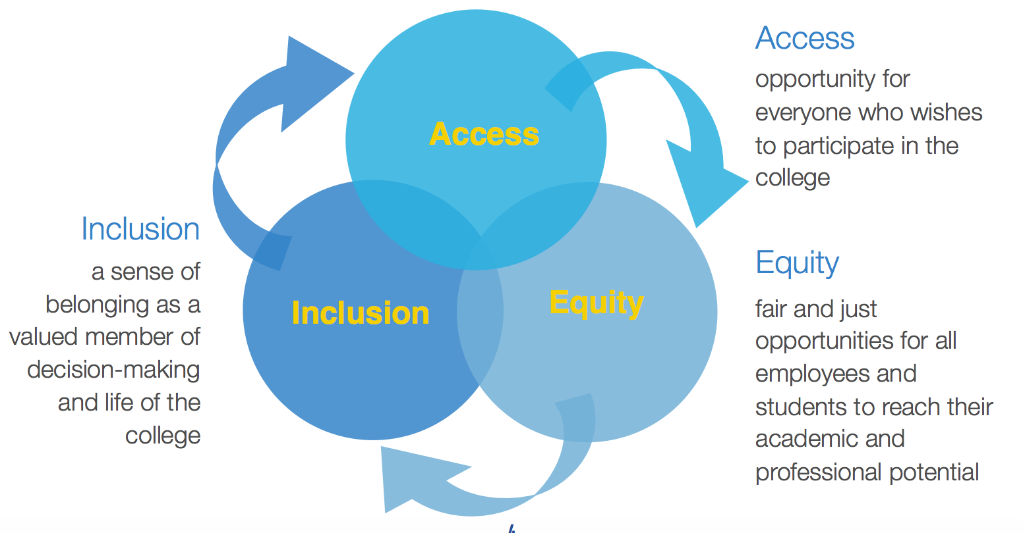
Unique Features of Lane’s Equity Lens
Lane’s Equity Lens will be intersectional. It will encompass the entire campus community.

Slide 6
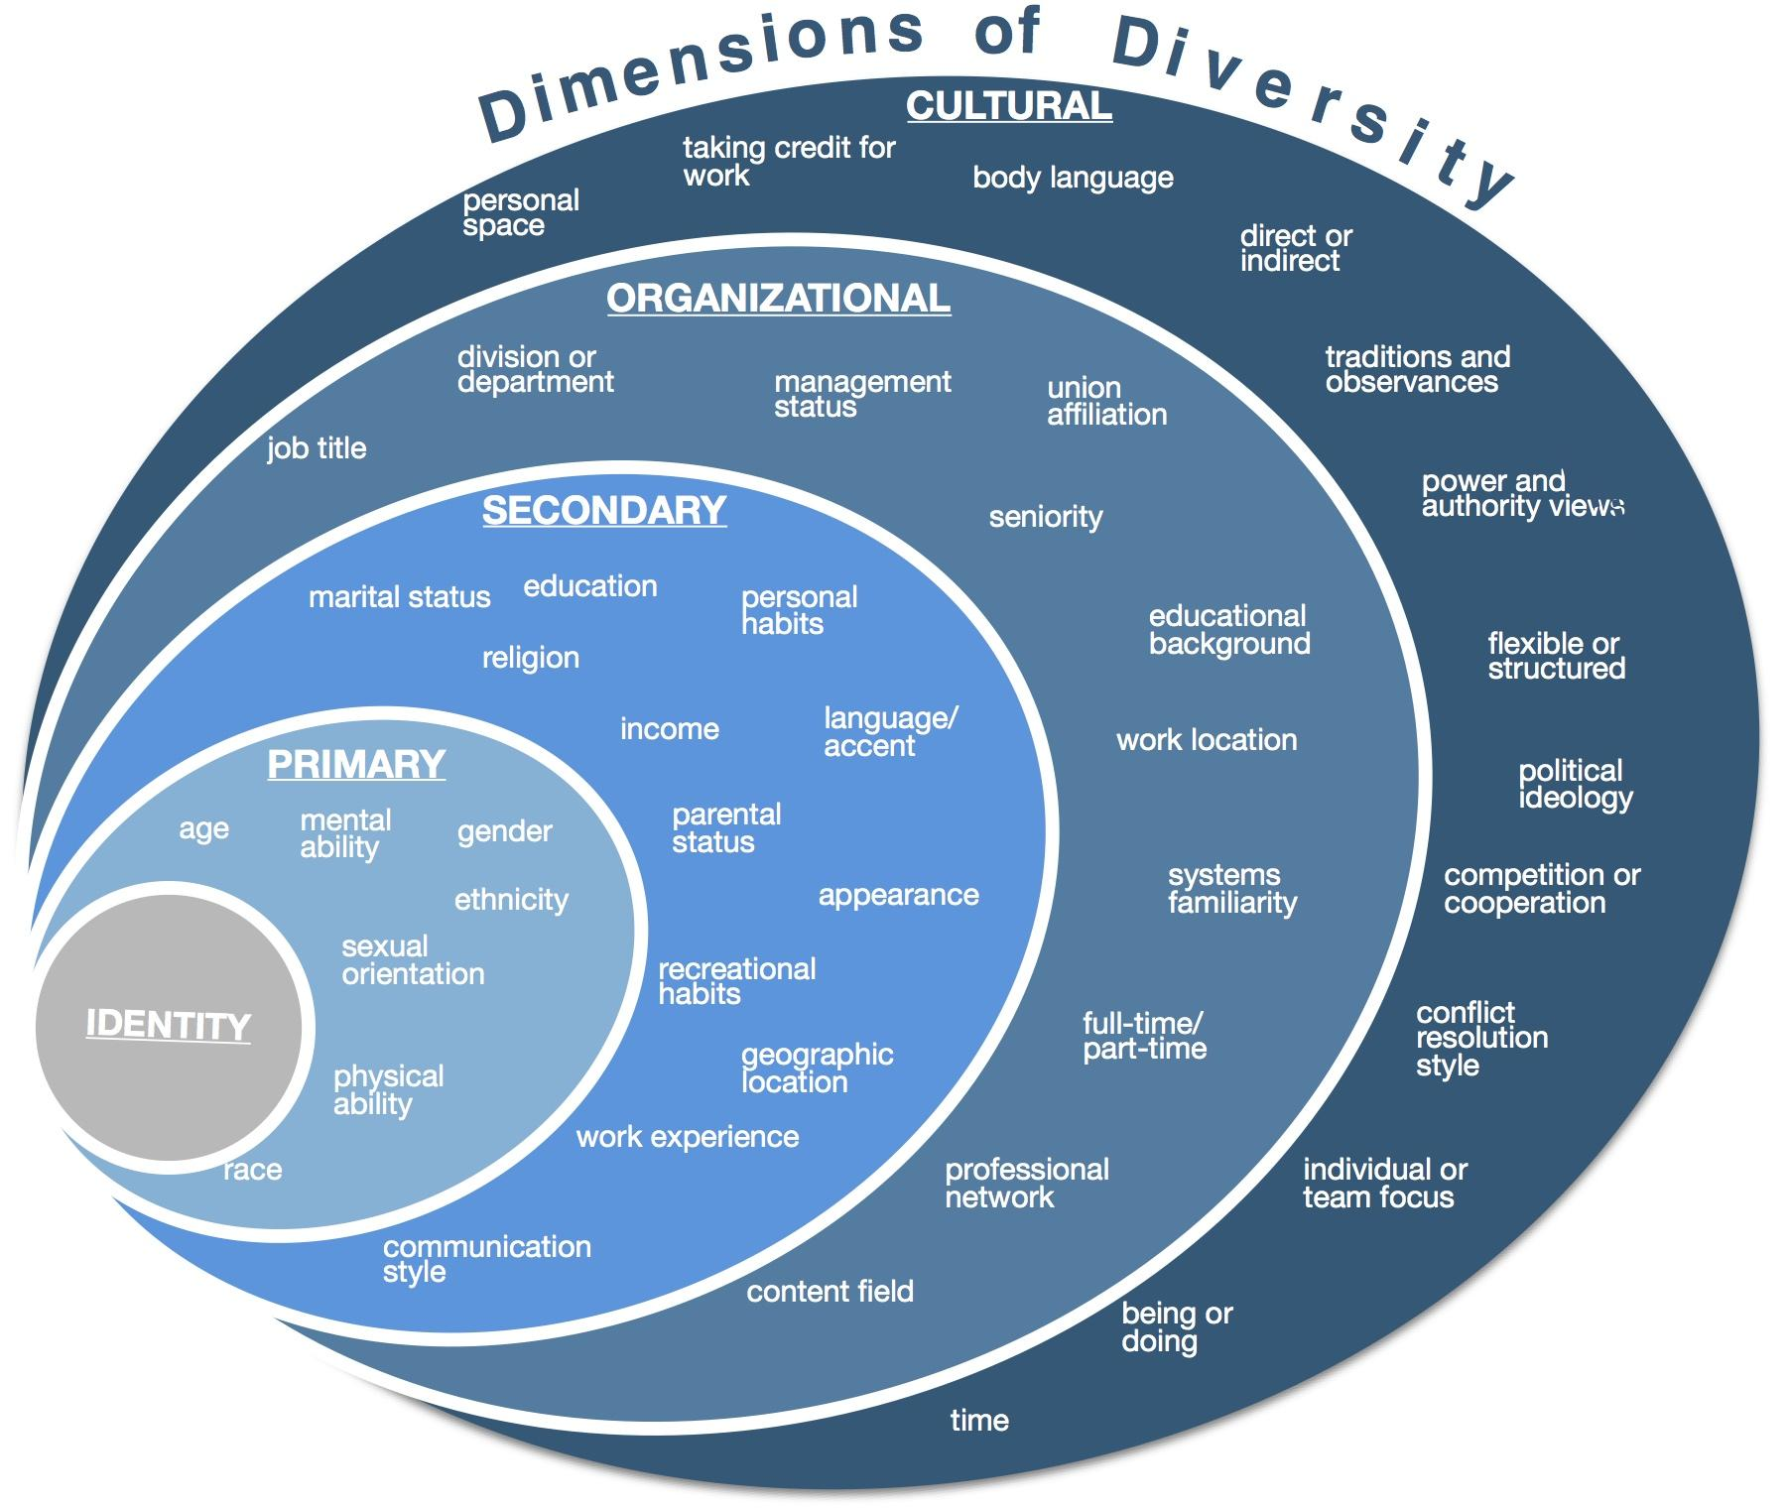
Intersectionality is a term coined by American civil rights advocate Kimberlé Williams Crenshaw in the late 1980’s. The term is used to describe the ways in which social identities--such as gender, race, class, ethnicity, religion, sexuality, etc--intersect and overlap in ways that do not allow these identities and related systems of oppression--such as sexism, racism, classism, bigotry, homophobia, etc--to be examined separately.

Slide 7
Part One:
Definition
and
Vision

Slide 8
Example #1: City of Ottawa Equity Lens
“The Equity and Inclusion Lens is like a pair of glasses. It helps you see things from a new perspective. It helps you be more effective in your everyday work by getting a clearer focus and more complete view. This way, you can contribute to the full inclusion and participation of all residents and employees so that everyone can benefit from a vibrant city.”

Slide 9
Oregon Opportunity Network
Racial Equity Lens
(source: Portland Public Schools)
Objective: By utilizing a racial equity lens, Oregon Opportunity Network aims to (a) provide a common vocabulary and protocol for evaluating policies, programs, practices and decisions for racial equity and (b) produce policies, programs, practices and decisions which result in more equitable outcomes.

Slide 10
Definition and Vision
10 minutes
Definition: Lane’s Equity Lens will be used to reassess systems and decision-making to achieve access, equity, and inclusion on a college-wide level.
Vision: Through a framework of social justice, the Equity Lens helps us to acknowledge the existence and causes of systemic inequity at Lane. It provides opportunities for intentional healing, reconciliation, and empowerment. Honest, transparent, and consistent use of this lens enables the campus to create a culture of accountability and empower all members of our community.
Discussion #1:

Slide 11
Part Two:
Guiding Questions

Slide 12
Equity Lenses are usually framed by versions of the five following questions.
Additional questions are often added specific to organizational needs.
Who are the groups affected by this policy, program, practice or decision? And what are the potential impacts on these groups?
Does this policy, program, practice or decision ignore or worsen existing disparities or produce other unintended consequences?
How have you intentionally involved stakeholders who are also members of the communities affected by this policy, program, practice or decision in the decision-making process?
What are the barriers to more equitable outcomes around this policy, program, practice, or decision?
How will you mitigate the negative impacts and address the barriers identified above?

Slide 13
There is a sixth question often asked. Lane’s Equity Lens will include a version of this question.
How can we create space for healing and reconciliation to transform our structures, environments, and selves?

Slide 14
Guiding
Questions
10 minutes
Discussion #2:
We’ll use questions to ensure our focus is appropriate, and to evaluate individual issues in the equity lens framework.
(Please refer to the list of questions on your handout.)

Slide 15
Part Three:
Framework for Action

Slide 16
What else?
Open Discussion
Part Four:

