Slide 1
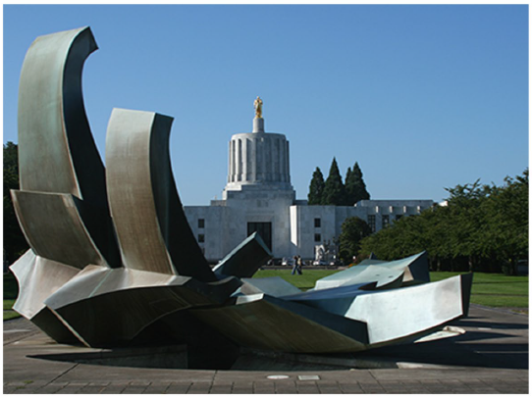
Oregon Funding Formula

Slide 2
Current Funding Model Based on FTE

Slide 3
NEW Funding Model

Slide 4
New Funding Model Based on
FTE + Student Support & Success

Slide 5
Student Support: Four Prioritized Populations
Low-income. The number of students who received a Pell Grant or Oregon Needs Grant sometime during the academic year at any college in Oregon.
Adult. The number of students who were aged 25 or older.
CTE/Workforce Training. The number of students enrolled in CTE programs
Underrepresented (URP) The number of students who identify in one of the groups below:
  Asian American/Asian
  Black/African American
  Latino/a/x/Hispanic
  Native American/Alaska Native
  Native Hawaiian/Pacific Islander
  Two or more of the above
The calculation is weighted by the number of groups a student identify with (2 groups add 20%, 3 groups add 30% and all 4 groups add 40%)

Slide 6
Student Success: Early Momentum Metrics
Non-credit. This measure indicates the number of students who have completed adult education and/or non-credit workforce training during the given academic year
15+ hours. This measure indicates the number of students who have earned at least 15 credits but fewer than 30 credits by that academic year. Students are counted in the year that they earn their fifteenth credit.
30+ hours. This measure indicates the number of students who have earned 30 or more credits by that academic year. Students are counted in the year that they earn their thirtieth credit.
Gateway course. This measure indicates the headcount of students who earned their first credit in a college-level writing or math course during the given academic year.

Slide 7
Student Success: Completion
Completions. This measure shows the number of students who earned a credential during the given academic year. It includes all HECC-approved degrees, CTE certificates, non-credit training certificates, Career Pathways certificates, and the recently approved Core Transfer Map completions
Additional weighting for completions earned by students in the student support groups (1.5). This measure shows the number of students identifying with one or more of the student support groups who earned a credential in the given academic year.

Slide 8


