Slide 1
How to Create & Approve Purchase Orders ExpressLane 9 ( Banner Self-Service)

Slide 2
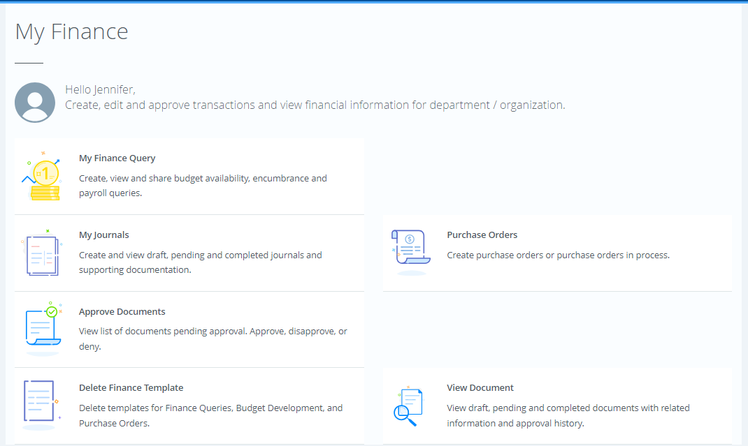
How to create a PO in ExpressLane 9 – Banner Help Services - 1
Go to ExpressLane 9
Login to Lane CAS
Enter your L Number and network password, Select Login
Click Purchase Orders

Slide 3
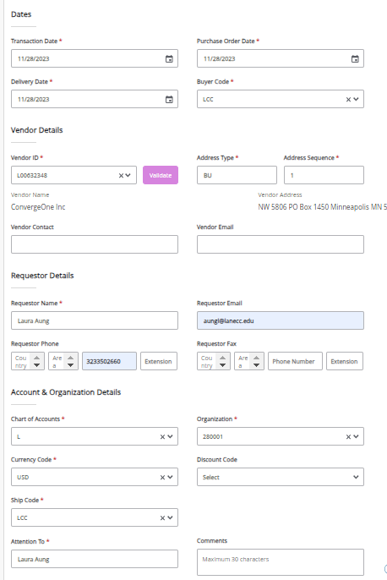
How to create PO in ExpressLane 9 – Banner Help Services-2
Select Transaction , Purchase , Delivery Date
Buyer Code is always LCC
Select Vendor ID and Click Validate , confirm Vendor information
Check Requestor Detail
If printing or emailing in Fpapord, add the requestor email you would like it to be emailed to
The fields Attention to and comments will also print on the PO in Fpapord
5. Check Account and Organization Details

Slide 4
How to create PO in ExpressLane 9 – Banner Help Services-3
Select Purchase Order Commodities
Enter U/M , Quantity, Unit Price
Validate the Commodity
Add additional lines as needed.

Slide 5
How to create PO in ExpressLane 9 – Banner Help Services-4
Enter Purchase Order Accounting
Choose either Dollar or Percent
Chart for Lane Community College is always L
Enter Fund , Organization, Account , Program ( FOAP)
Enter Accounting ( % or Dollar Value applicable to FOAP)
Validate and Complete

Slide 6
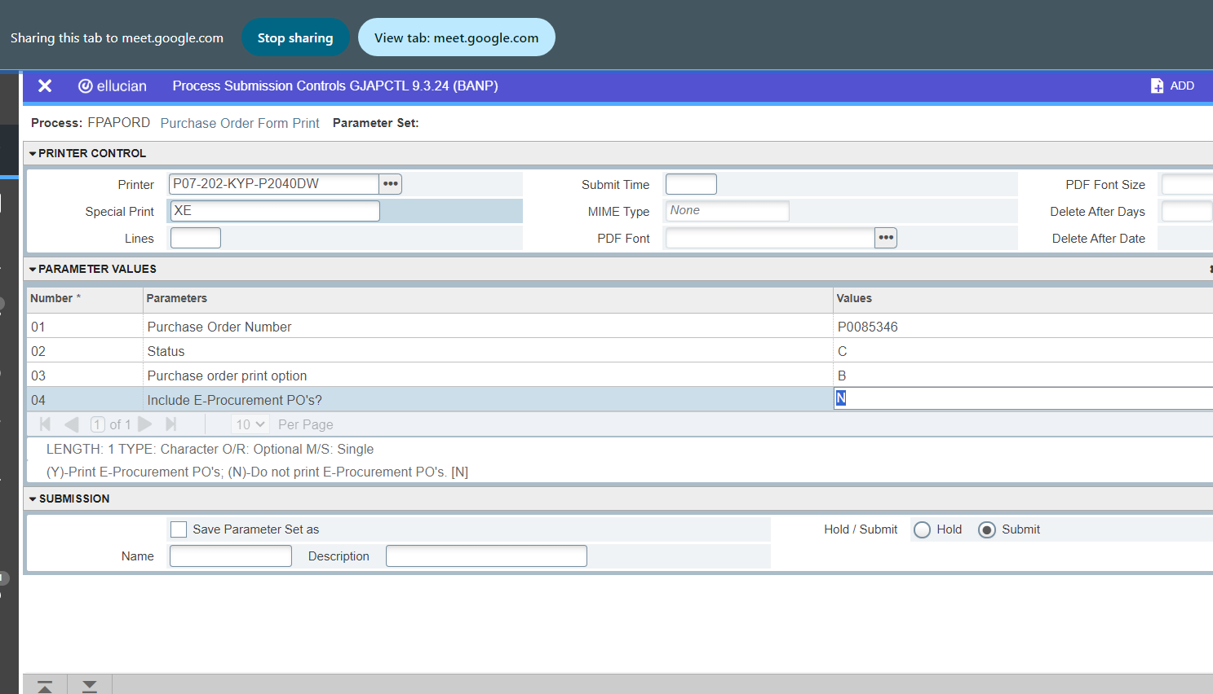
How to print Express 9 entry PO
Go to Banner / enter FPAPORD/Choose Banner Printer/Enter Special Print Parameter –XE

Slide 7
4.c. Purchase Order Approval
Purchase Orders will be reviewed and approved through “ExpressLane (Banner Self-Service) ” by the Workflow Approvers.
The following information will be verified:
Order type (regular vs standing)
Vendor name
Contract agreement if any
Purchase description and cost
Applied FOAP (fund, organization, account, & program)
2. After the PO is approved, the requestor needs to submit the documentation to the vendor. Always attach contracts/quotes.
3. Always confirm vendor acknowledgement and delivery date .

Slide 8
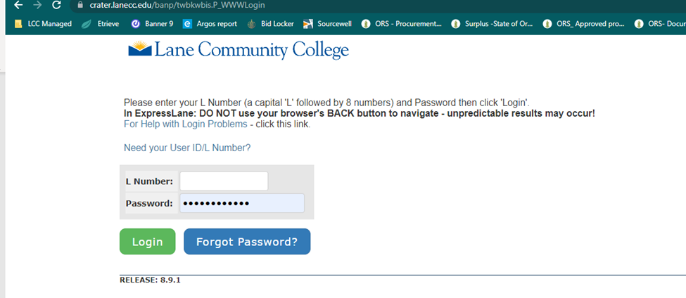
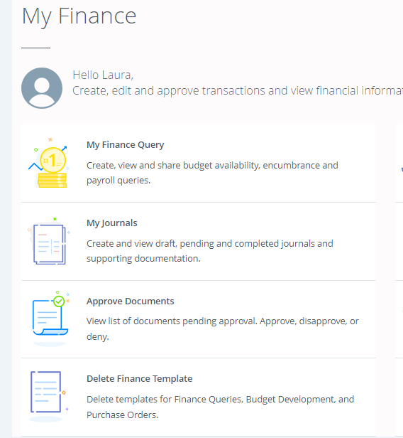
Steps for PO approval in Express Lane

Slide 9
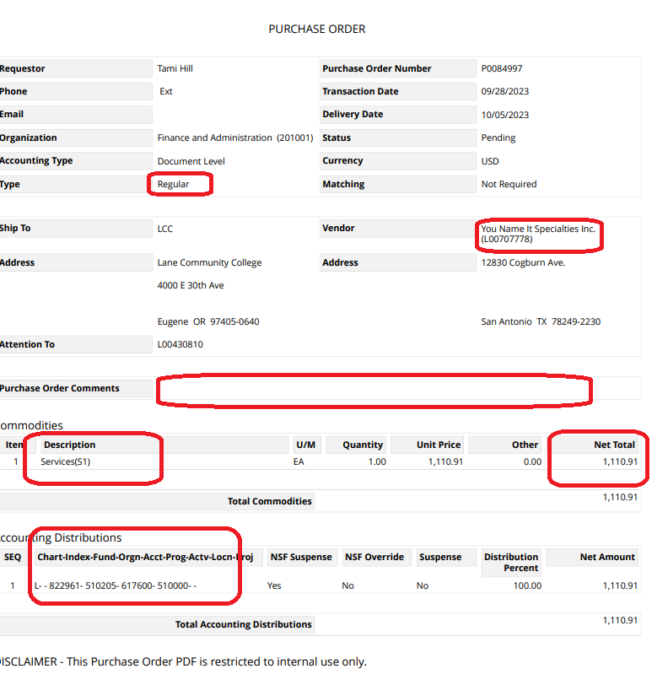
Check points for Approver
Notes :
There is no email notification for the approver
As an approver, you are responsible for checking ExpressLane perpetually

Slide 10
The Role of the Approver
Budget Managers and higher-level personnel are among those who may serve as Approvers. Approvers are:
Responsible for reviewing and endorsing purchase requests regularly and confirming adherence to budgetary requirements
Guaranteeing the best possible value for the purchase
Approving purchase orders
Overseeing delivery, and resolving any problems or conflicts that may arise

Slide 11
Any questions? Please email to contractprocurement@lanecc.

