Slide 1
Contract and Procurement Orientation
Contract and Procurement Services Orientation

Slide 2
Purpose of Presentation
Purpose of Presentation
The primary purpose of Contract and Procurement Services is to support, aid, and assist college staff in obtaining the best value available for goods and services, while maintaining college compliance with all relevant laws and regulations.
Contract and Procurement Services is responsible for all purchases made on behalf of the college. The intent of this presentation is to understand how to process a contract or purchasing.

Slide 3
Content
Content
Contracting Process
Approval Requirements
User Guideline
Purchase Order Process
Purchasing Cards
Contracts and Record Keeping
Contacts

Slide 4
Approval Requirement
2. Approval Requirement
Contract Economics Value | Process Approval Requirement | Procurement Method
Public Improvement ≥ $150,000, Good and services ≥ $100,000 | Board of Education Requirement is necessary expect emergency procurement. | All procurements will require public advertising, Competitive sealed document processes, as well as numerous additional statutory requirements
All purchase ≥ $50,000 | President, D.P.O ( dedicated procurement officer), C.P.O (President Assigned Officer) | Intermediate Procurement- 3 quotes ( 2 from open market and 1 from COBID ) policy is applied unless certified cooperative procurement , intergovernmental and state agreement . A competitive process consists of solicitation of either Quotes, Bids or Proposal. In unusual cases, it may be appropriate to exempt governed by state law will require and record, Contact Procurement services for specific detail.
All purchase ≥ $25,000 | Cabinet Members ( Vice President, Assistant Vice President )
All purchase ≥ $10,000 | Budget Authorities and Procurement Administrator
All purchase ≥ $3,000 and < $10,000 | Require a Purchase Order | No documentation of a competitive process is required, but Budget Authorities are expected to exercise prudent financial judgment when spending public funds
< $3,000 | May qualify for payment by Purchasing Card (P-Card).
*COBID -Certification Office for Business Inclusion and Diversity
*Economics Value- Total cost of ownership or , Life Cycle Costing

Slide 5
User Guideline
3. User Guideline
Procurements at or above $10,000 require a competitive process, or documentation of an exemption from such a process, consistent with the Oregon Public Contracting Code. The competitive process to be used for purchases of $10,000 or above will be either an Invitation For Bids or Quotes (an IFB or IFQ), or a Request For Proposals (RFP).
In making this decision, and in producing the IFB/Q or RFP, departments are always encouraged to consult with Purchasing Services at the beginning of the process.
An RFP is used when factors other than price (quality of goods, experience/qualifications of service providers, etc.) need to be considered. Before a vendor can be selected and an order placed (for purchases of $10,000 or greater, but less than $100,000), college departments must first obtain a minimum of three Responsible and Responsive Proposals.
This process closely resembles a hiring committee, in that the potential vendors are given a description of what the college needs, called a Scope Of Work, and a set of questions to be answered in the form of a Proposal. Then, the College has a team of staff review the Proposals, and score each element consistent with the documents given to the potential vendors (or) advertising public announcement.

Slide 6
Selection of Procurement Methods : Bids/Quotes or Proposals
Selection of Procurement Methods : Bids/Quotes or Proposals
Procurements at or above $10,000 require a competitive process, or documentation of an exemption from such a process, consistent with the Oregon Public Contracting Code. The competitive process to be used for purchases of $10,000 or above will be either an Invitation For Bids or Quotes (an IFB or IFQ), or a Request For Proposals (RFP).
In making this decision, and in producing the IFB/Q or RFP, departments are always encouraged to consult with Purchasing Services at the beginning of the process.
An RFP is used when factors other than price (quality of goods, experience/qualifications of service providers, etc.) need to be considered. Before a vendor can be selected and an order placed (for purchases of $10,000 or greater, but less than $100,000), college departments must first obtain a minimum of three Responsible and Responsive Proposals.
This process closely resembles a hiring committee, in that the potential vendors are given a description of what the college needs, called a Scope Of Work, and a set of questions to be answered in the form of a Proposal. Then, the College has a team of staff review the Proposals, and score each element consistent with the documents given to the potential vendors (or) advertising public announcement.

Slide 7
General Guideline for Obtaining Proposals Ethically and Responsibly
General Guideline for Obtaining Proposals Ethically and Responsibly
Before obtaining Proposals, departments must first establish the scope of work to be performed, specification of job and the criteria to be used in evaluating (scoring) Proposals. Only factors which were specified in the solicitation may be evaluated and/or scored.
Give all potential vendors the same information, in writing if there are complicated requirements or other information. Potential vendors must be contacted in the same manner, and as close to each other in time as is possible.
Never disclose Proposal content beyond the confines of college staff until an award is made.
Tell potential vendors if you intend to split the award between two or more vendors.
May not negotiate pricing but always check shipping, education discount , time frame of price validity, after service , life cycle cost, certification etc.
Do not add non-Quoted items to the Quote after award is made.
Purchases may be considered to ensure that no conflict of interest exists. Purchases of products and services from College employees or their immediate family members (spouses, parents and children) are discouraged, except under certain circumstances.
Don't place an order before the Proposals is approved.
This guidance is general in nature, and due to the complexity of the Oregon Public Contracting Code cannot be comprehensive, or fully address all possible situations

Slide 8
Methods of Communication
Methods of Communication
Obtaining Quotations
Departments can directly contact potential vendors for procurements of less than 10K. If the total value of the procurement is 10K or greater, departments need to obtain a minimum of three quotes. The specifications are provided to all the potential vendors contacted in the same manner, and as close to each other in time as is possible. Potential vendors may provide a Quote by email, fax, or regular mail.
All project above 100K require public notification and a S.P.C.( single point of contact)
Approving Quotation
Potential vendors may provide a Quote by email, fax, or regular mail. After the selection is completed by the department, procurement services must approve the selected quotation. The PO can be placed after the selected quotation is approved. A Quote Tabulation Form may be obtained at Etrieve. If assistance is needed, please contact contractprocurement@lanecc.edu.
Notifying Vendors a Contract has Been Awarded
For certain small procurements, college employees may simply use a Purchasing Card to conduct their transaction. Otherwise, the appropriate means of informing a vendor that the college has awarded them a contract is by issuing a Purchase Order (or) mutually agreed upon signed contract.

Slide 9
Purchase Order Process
4. Purchase Order Process
Vendor Setup
Creating a Purchase Order
Approval Process
Change Orders
Purchase Order Receiving and Submitting Invoices
Purchase with Pcard
Contract Records

Slide 10
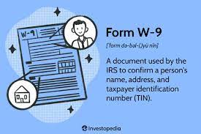
Vendor Setup
4.a. Vendor Setup
Upload the vendor’s general information into Softdocs (Etrieve)Vendor Setup. This should include a W9 form.
College Finance will use this information to register the new vendor in Banner and create an “L” number that will be unique to this vendor.
This “L” number will be used to create the purchase order.
If any credit application is required, please contact College Finance to have this completed and signed.

Slide 11
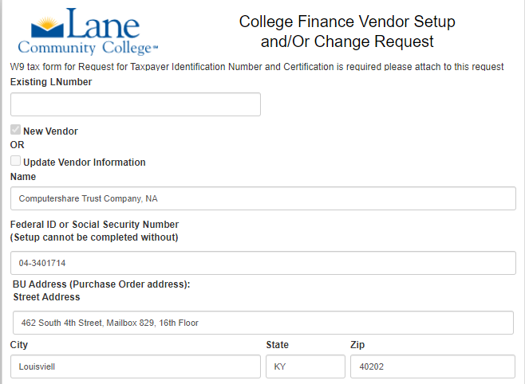
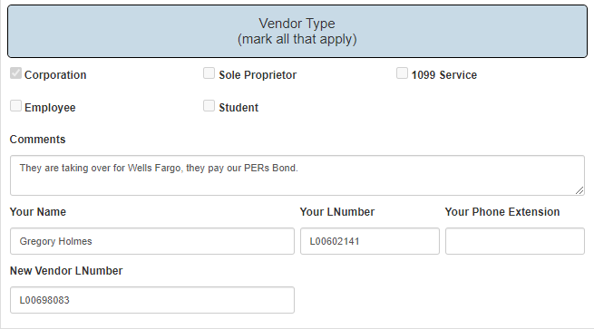
Vendor Setup Form
Vendor Setup Form

Slide 12
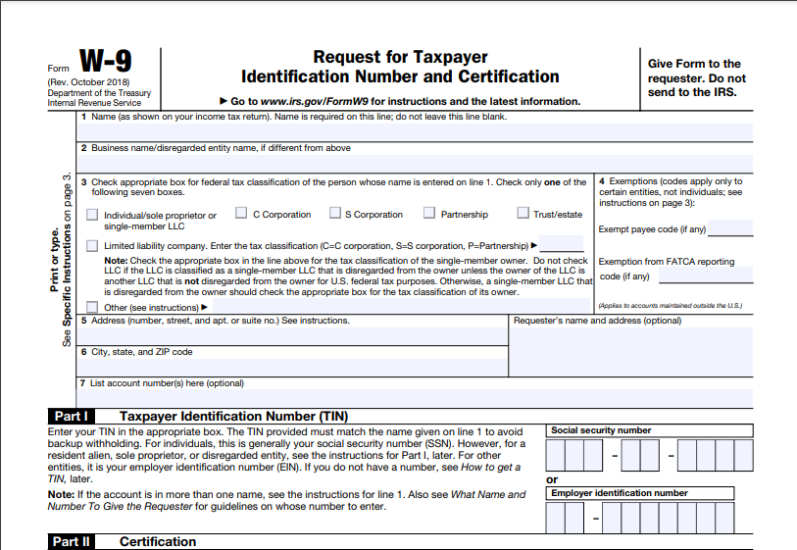
W-9 form

Slide 13
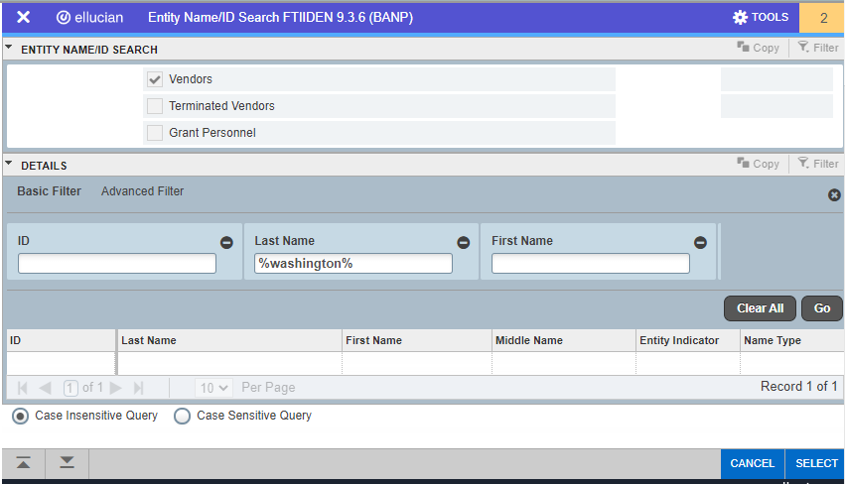
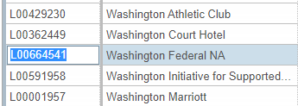
How to find vendor L number in Banner
FTIIDEN- How to find vendor L # in Banner

Slide 14
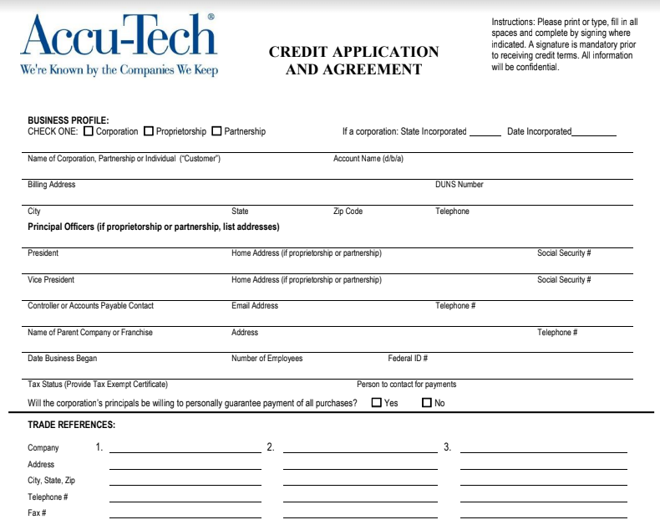
Credit Applications
Credit Applications

Slide 15
Creating a PO
4.b. Creating a PO
You can create a Purchase Order in Banner / Enter FPAPURR (Purchase Order) and complete the PO.
how to create PO in Banner
For placing orders for a one-time purchase and payment of line item goods that have a specific quantity and unit price select “Regular Purchase Order”. “Standing purchase orders” are allowed to use for recurring charges to the same vendor over the same fiscal period and may not exceed a total value of $100K.
Please make sure you have budget to purchase i.e check your FOAP ( Fund, Organization, Account, Program) prior to your PO being processed. Otherwise, a NSF (non sufficient funds) approval is required which may lead to an additional turn-around time
Please reach out to Linda Reling or Greg Davies should you have any questions

Slide 16
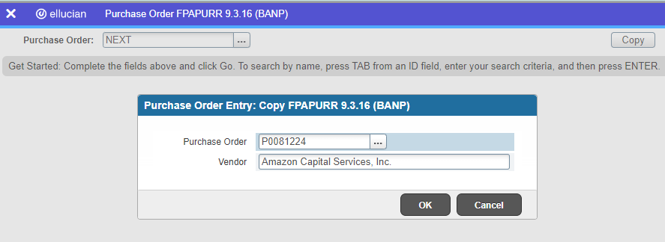
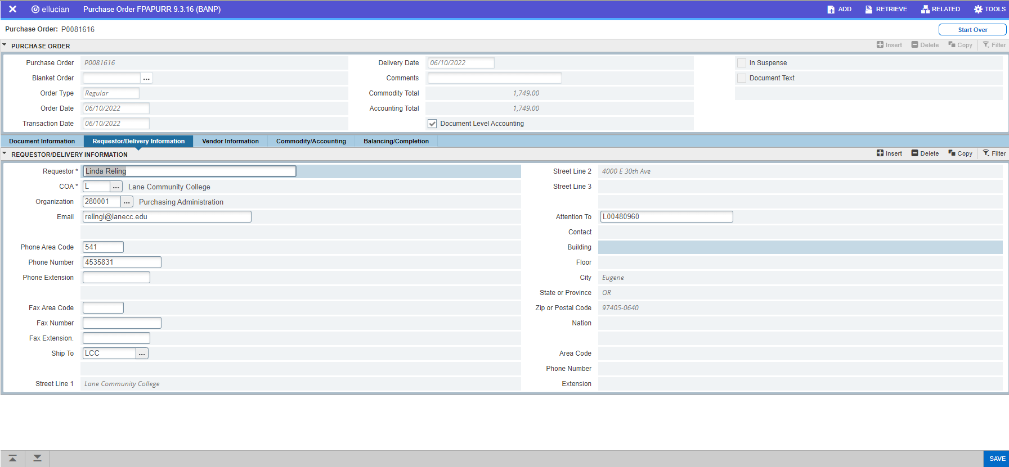
Banner Purchase Order
FPAPURR –Banner Purchase Order

Slide 17
Purchase Order Approval
4.c. Purchase Order Approval
Purchase Orders will be reviewed and approved through “Expresslane (Banner Self-Service) ” by the Workflow Approvers.
The following information will be verified:
Order type (regular vs standing)
Vendor name
Contract agreement if any
Purchase description and cost
Applied FOAP (fund, organization, account, & program)
2. After the PO is approved, the requestor needs to submit the documentation to the vendor. Always attach contracts/quotes.
3. Always confirm vendor acknowledgement and delivery date .

Slide 18
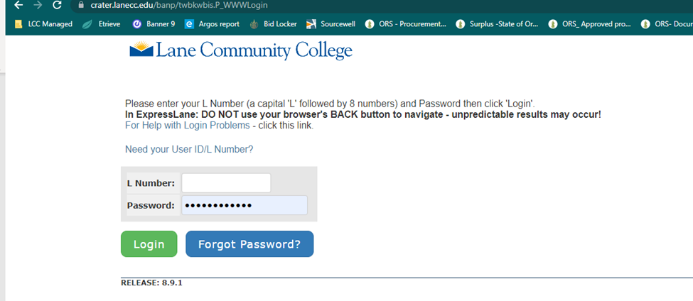
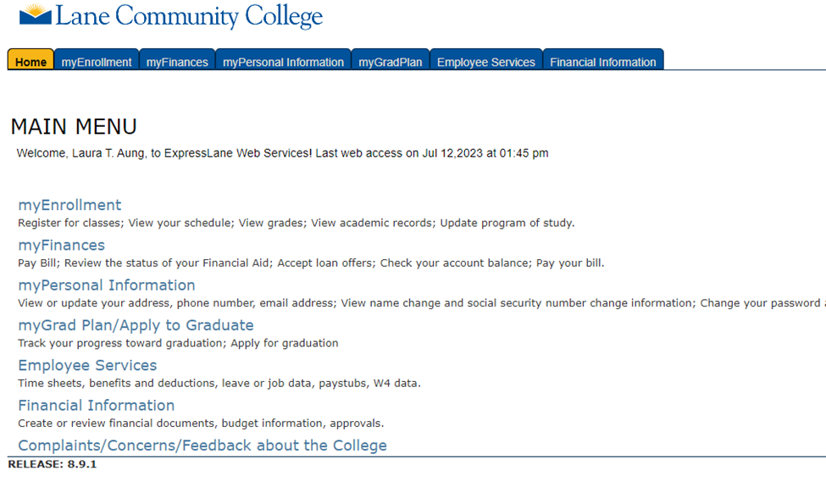
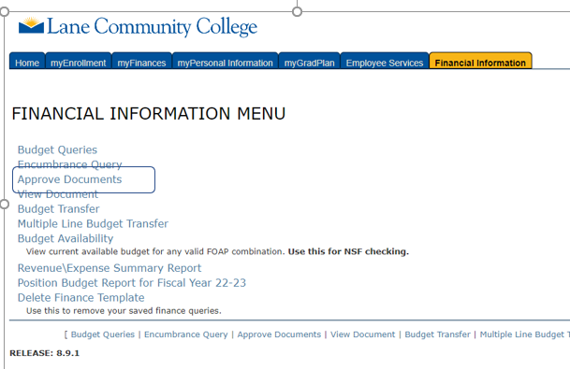
Steps for PO Approval in ExpressLane
Steps for PO approval in Express Lane

Slide 19
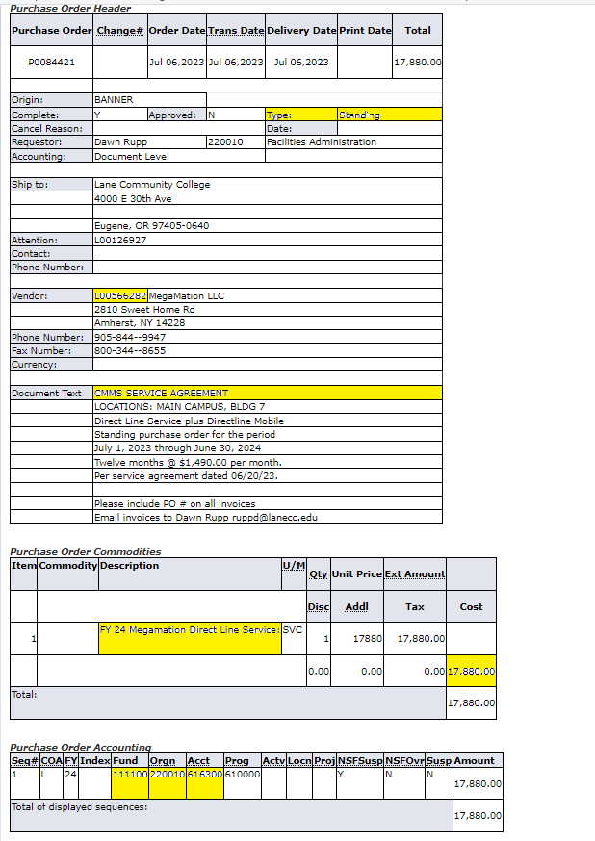
Check points for Approver
Check points for Approver
Notes :
There is no email notification for the approver
As an approver, you are responsible for checking perpetually

Slide 20
The Role of the Approver
The Role of the Approver
Budget Managers and higher-level personnel are among those who may serve as Approvers. Approvers are:
Responsible for reviewing and endorsing purchase requests regularly and confirming adherence to budgetary requirements
Guaranteeing the best possible value for the purchase
Approving purchase orders
Overseeing delivery, and resolving any problems or conflicts that may arise

Slide 21
Change Orders
4.d. Change Orders
Amendments may not exceed a total of 33% of the original contract price for goods & services.
Amendments may also not exceed 25% of the original contract price for public improvements, public works, or general trade services.

Slide 22
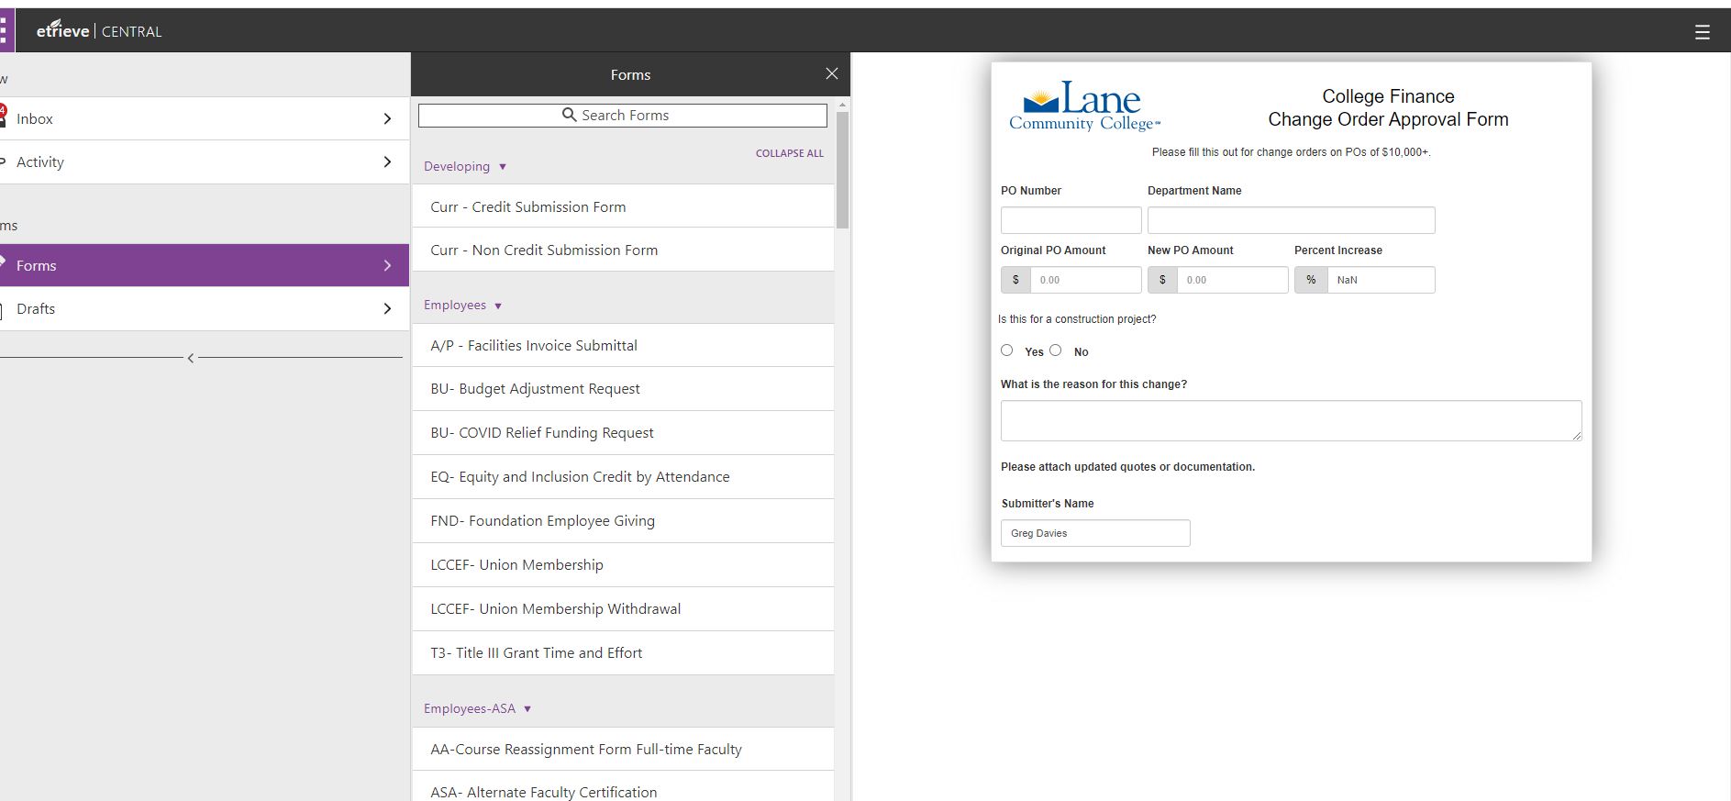
Change Orders Process- Step 1
Change Orders Process- Step 1
Submit a request through Etrieve Change Order

Slide 23
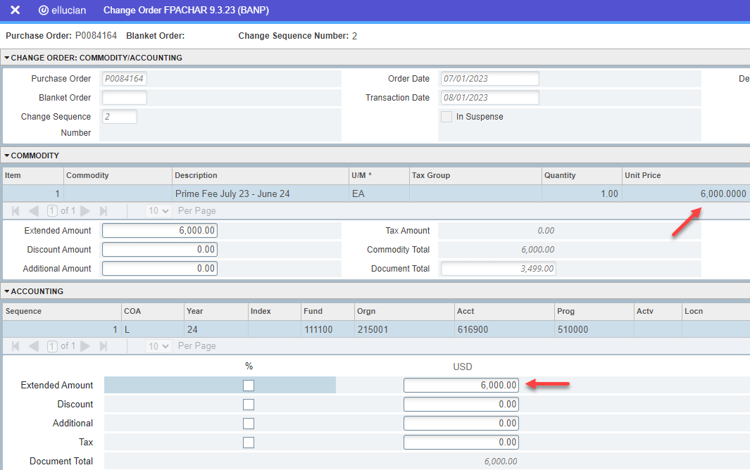
Change Orders Process- Step 2
Change Orders Process- Step 2
Once the change order form has been approved, process the changes in Banner.
Go to FPACHAR (or) Change Order
Enter the PO #, then type “Next”, & Go
Click “Change Accounting Only”, Save, and Alt+PgDn
Change amount in the Commodity & Accounting boxes, Alt+PgDn
Select Complete
The Change Order will go through the same Approval Process as POs
Detailed Instructions: Create a Change Order

Slide 24
PO receiving & Submitting Invoices
4.e. PO receiving & Submitting Invoices
Purchase Order Shipments are delivered to College Receiving (bldg. 9) and the package will be distributed to the appropriate department
Upon validation of orders, invoices shall be submitted to the Accounts Payable through Softdocs (Etrieve) - Invoice Submittal
If the amount of the order is >$500, the requestor must submit the packing list with the invoice
The Accounts Payable Team may reach out to the requestor for delivery confirmation prior to the vendor being paid if needed
In the event that advance payment is required, contact the Procurement/AP Team prior to placing the order

Slide 25
5. Purchasing Card ( P-card)
5. Purchasing Card ( P-card)
P-Cards were implemented to allow departments to make low dollar purchases easily, and with minimum processing expenses. Designated department budget authorities can use their department credit card for purchases.
Pcard policy
Pcard Application and agreement

Slide 26
6. Contract Approval and Records Keeping
6. Contract Approval and Records Keeping
Once the RFP/RFQ process is completed, it's time to finalize the contracts. These contracts must adhere to the college's Contract Approval Procedure
A signed contract should be forwarded to the Contract and Procurement Director for record-keeping purposes.
When renewing an existing contract with a new purchase order request, ensure that the contract is included with the supporting documents.
It’s is always advisable to engage Procurement Services when addressing renewals or reviews of contracts

Slide 27
Contacts
Contacts
Laura Aung – Large Purchases, RFPs, & Contracts, General
Greg Davies – Purchasing Questions, PO approvals, & Fixed Assets
Linda Reling-Davis - PO Training, Banner & Etrieve help
Pam King – Pcards & Vendor Setups
Pam & Linda - Invoices, Stop payments, Check Research, & Vendor History
Thank you.
Contract and Procurement Services

Slide 28
References
References:
https://oregon.public.law/statutes/ors_chapter_279
https://occa17.com/resources/procurement/
https://go.boarddocs.com/or/lanecc/Board.nsf/goto#
https://inside.lanecc.edu/copps
chrome-extension://efaidnbmnnnibpcajpcglclefindmkaj/https://inside.lanecc.edu/sites/default/files/collfin/lane_community_college_rules_of_procurement_october_20_2021.pdf

