Slide 1
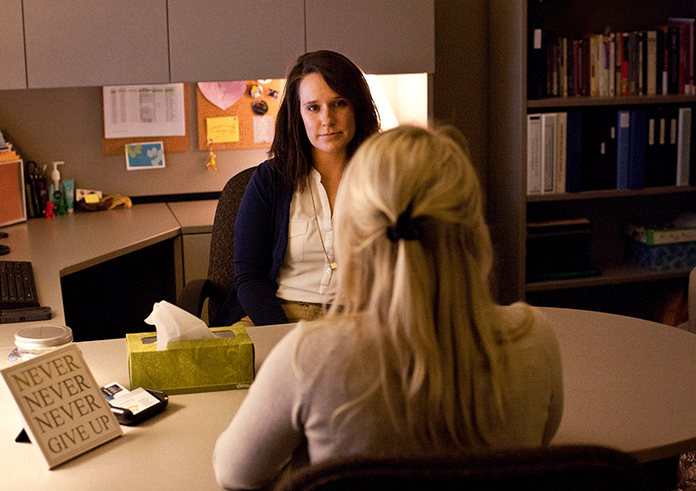
Gender Equity Center
Title IX
Photo courtesy of Rape Crisis Center, TN

Slide 2
Question:
What do you already know about Title IX?
How are you affected by it?
Notes:
https://www.womenssportsfoundation.org/advocate/title-ix-issues/history-title-ix/history-title-ix/
<number>

Slide 3

OVERVIEW : WHAT IS TITLE IX of The Educational Amendments of 1972
First enacted in 1972, it was historically established to combat gender/sex discrimination in college programs, specifically athletics.
Is now interpreted and applied to all college programs, specifically in regards to Sexual Respect. This includes protections for victims of assault and harassment who were targeted because of their sex/gender/sexual orientation.
Women’s Sports Foundation
Notes:
https://www.womenssportsfoundation.org/advocate/title-ix-issues/history-title-ix/history-title-ix/
<number>

Slide 4

OVERVIEW : WHAT IS TITLE IX of The Educational Amendments of 1972
Enforced by Federal Government, and because we receive federal funding, we are required to enforce the regulations
“Protects people from discrimination based on gender in any federally-funded, educational-related program and/or activity and
Requires educational institutions to provide students AND employees with an environment safe from sexual misconduct, such as sexual harassment and sexual violence.”

Slide 5

Sexual Respect at Lane
Lane Community College does not tolerate sex or gender discrimination. This includes sexual misconduct such as sexual harassment and sexual assault, stalking, and intimate partner dviolence.

Slide 6
Know your IX: Video
Know your IX: Video
https://www.youtube.com/watch?v=lFAs9fegJsI

Slide 7
Know your IX
Stop the sexual misconduct and discrimination
Provide training to all members of the community including students and staff
Enforce measures that protect students and employees from sexual misconduct and discrimination

Slide 8
Know your IX
Investigate reported cases both on and off campus of sexual misconduct and discrimination promptly, fairly, and impartially
Prevent its recurrence
Provide resources
Remedy the negative effects experienced by the victim and the community

Slide 9
Question:
Who is responsible for reporting a Title IX concern?
Are you?

Slide 10

Who is responsible for reporting sexual misconduct?
There are three categories of employees who have special duties:
  Title IX Coordinator: individual designated by college
  Confidential employees: Campus Counselors Privileged Confidential—any licensed confidential employee
    Regular Confidential—college designated
  Responsible employees: any person who can take action

Slide 11




Sexual violence on campus
You may already know that…
As many as one in five women experience unwanted sexual intercourse while attending a U.S. college (U.S. DEPARTMENT OF JUSTICE, 2007).
One in 12 college men admit to acts that meet the legal definition of rape (AMERICAN ACADEMCY OF PEDIATRICS, 1994).

Slide 12
Sexual misconduct is…
Sexual harassment
Non-consensual sexual contact (or attempts to commit same)
Non-consensual sexual intercourse (or attempts to commit same)
Domestic violence/dating violence/intimate partner violence
Sexual exploitation

Slide 13

Sexual and physical violence
is about power
&
control.

Slide 14
Sexual violence is rooted in oppression.
Data shows people with certain traits at higher risk of perpetration, such as:
Being male
Having sexually aggressive friends
Witnessing or experience violence as a child
Drug or alcohol use
Exposure to social norms supporting and promoting sexual violence
American Academy of Pediatrics and SATF

Slide 15
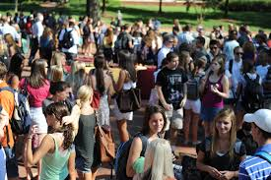
Question:
Which groups are at higher risk of experiencing sexual violence?

Slide 16
Data shows these groups are at a higher risk of victimization….
Women LGBTQ community Gender minorities Communities of color Students experiencing homelessness International students Sex workers | Students with disabilities Deaf and hard of hearing Intoxicated students Minors Undocumented students Non-English speaking students

Slide 17

Programming for preventing violence
“Creating safe spaces for victims and survivors to talk about their experiences is a key piece of prevention programming.”
SATF campus prevention

Slide 18
Question:
What keeps victims from reporting sexual violence?

Slide 19
Barriers to reporting
sexual violence
Why students do not report sexual violence:
Fear of not being believed
Fear of retaliation
Embarrassment
Fear of the reporting process
Unknown consequences; fear of the unknown

Slide 20

Only two to eight percent of assault cases are false reports.
The closer the relationship is between the victim and the perpetrator, the less likely the victim is to report.

Slide 21
Do students report sexual assault to a college source?
90% of students who had a nonconsensual sexual experience did not tell any college source.
86% of those who were raped did not tell any college source.

Slide 22

“Victims/survivors who experience a supportive and compassionate response, regardless of the criminal justice outcome, have lower rates of post traumatic stress.”
Campbell, et al. (1999). “Community Services for Rape Survivors: Enhancing Psychological Well-Being or Increasing Trauma.”

Slide 23
Those affected by sexual violence often experience trauma
Trauma may cause victims to:
Experience frozen fright
Be unable to recall all moments of the assault
Show a lack of emotion after an assault
Tell their story inconsistently; it seem as if they are making up the story as they go along
“College life may become so stressful that they [victims] develop clinical symptoms of trauma or anxiety that affect their mental and physical health.”
American Health Association
Notes:
<number>

Slide 24
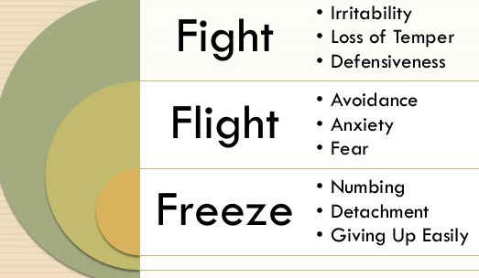
Trauma may cause freezing and/or desire to fight or flee
A mix of hormones causes increased breathing, eyes to close, immobility, paralysis
Between 12 and 50 percent of rape victims experience some moment of tonic immobility (loss of speech)
These may be more common in survivors of multiple assaults

Slide 25
Trauma may cause inconsistencies in memory
Memory may appear:
Out of order
Highly sensory
“Patchy”
Difficulty in recalling events and details
Victims are chosen because they are (or appear):
Vulnerable or can be made vulnerable.
Accessible or can be made accessible.
Most often, lacking in credibility or can be made so.

Slide 26
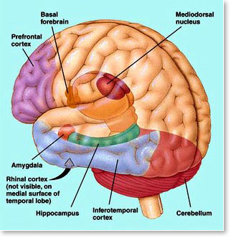
Primary causes of
trauma:
Betrayal
Extreme fear or terror
Surprise attack
Blame; invalidation
Lack of support

Slide 27
Once a school has notice of possible sexual harassment of a student
the school should…
Find out what happened via investigation
Take prompt and effective action to end the harassment
Remedy the effects
Prevent recurrence

Slide 28
Sexual misconduct reporting process
COMPLAINT
Students of Concern
Public Safety
INVESTIGATION
Investigate what occurred
FINDINGS
T9 Coordinator
Take prompt and effective action to end the harassment
Prevent the recurrence
Responsible
Not responsible
APPEALS
FINAL OUTCOME
Remedy the effects

Slide 29
Reporting sexual assault
at Lane Community College
https://publicdocs.maxient.com/reportingform.php?LaneCC&layout_id=2
The above link is to LCC’s reporting form. A report can be submitted by the student or on behalf of the student involved in the assault.
This can also be found in COPPS under “Student Complaint Procedure: Formal,” which provides links to file different grievances.

Slide 30
Training—get engaged!
Website: http://lanecc.or.safecolleges.com/login
Sexual Assault Dynamics on Campus training: https://www.youtube.com/watch?v=_tsfJvOus7o
Modules to review:
Sexual Harassment Policy and Prevention,
Title IX and Sexual Misconduct,
Campus SaVE Active for Employees – Sexual Violence Awareness.
Login info: Lane employees who have not previously used SafeColleges may establish a login for SafeColleges by using their L# and setting up a password.

Slide 31
Confidential Resources
Counseling Center
  Building 1, Room 103
  541-463-3600
Health Clinic
  Building 18, Room 101
  541-463-5665

Slide 32
Title IX Contacts at Lane
Title IX Coordinator:
  Terrie Minner
  (541) 463-3010
  minnert@lanecc.edu
Deputy Title IX Coordinators:
  Dennis Carr
  (541) 463-5585
  carrd@lanecc.edu
  Carl Yeh
  (541) 463-5787
  YehC@lanecc.edu

Slide 33
Questions for me?

